Slide 1
Stream Connectivity Update
June 3rd, 2025
Brandon Allen

Slide 2
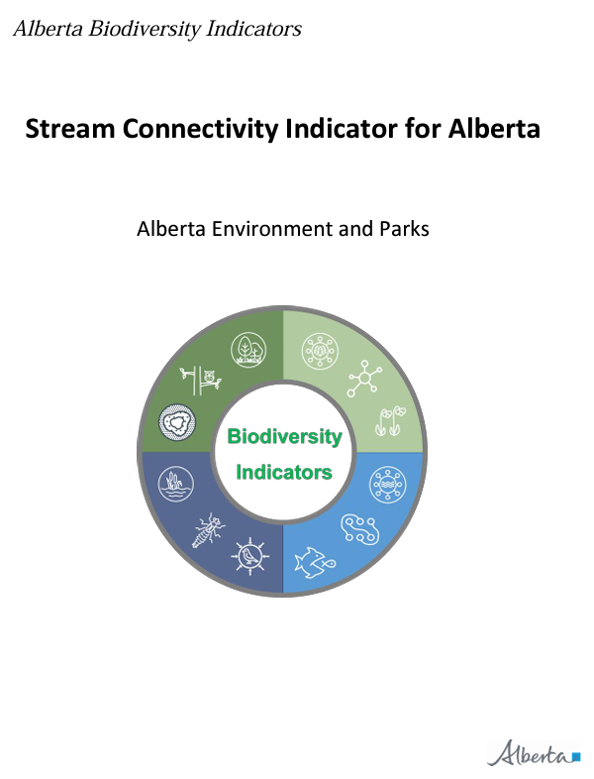
Stream Connectivity
Updates
      New Human Footprint Inventories have been integrated.
      New culvert data has been integrated.
      Entire coding pipeline has been simplified.
      Resolving discrepancies with the new hanging culvert model.
Notes:
Initial indicator was released August 24th, 2021.

Slide 3
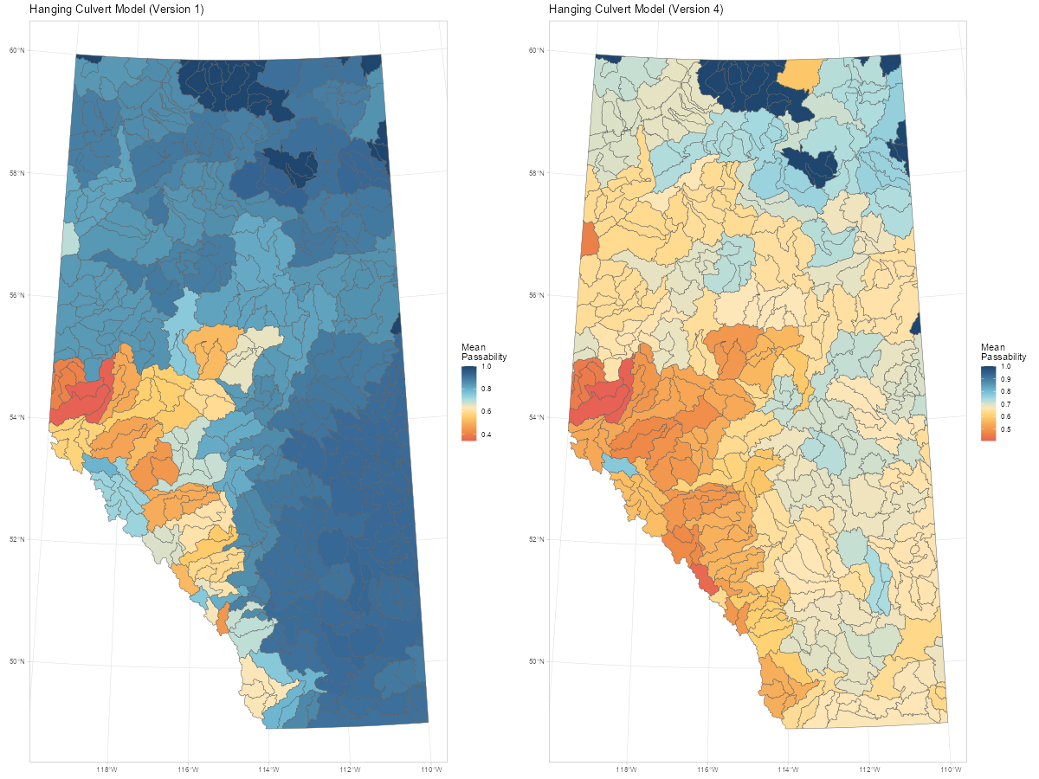
Hanging Culvert Model
Issue
      Model was showing a higher prevalence of hanging culverts throughout the grassland and parkland (where we are data deficient).
      Explored multiple modeling approaches but observed minimal impacts.
        Two different model regions.
        Different covariates
        Etc.

Slide 4
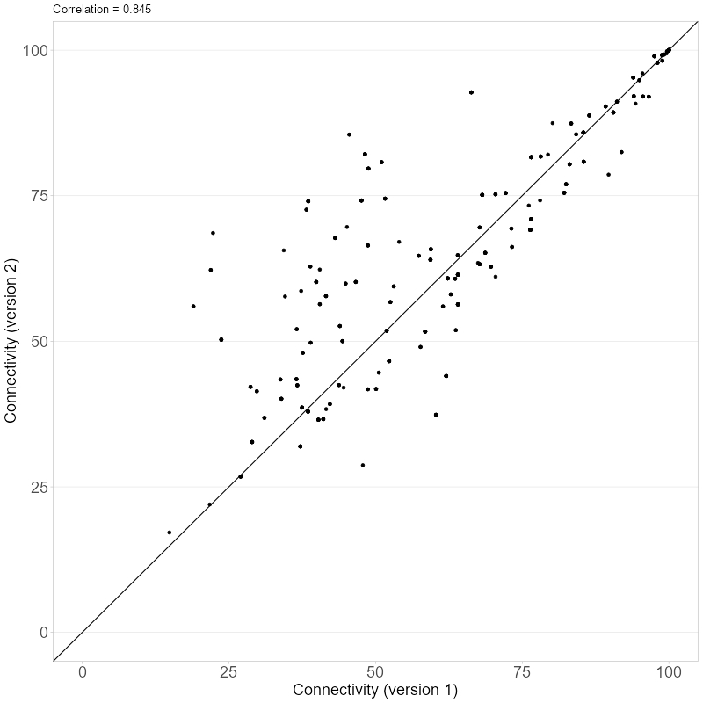
Stream Connectivity
Issue
      When implementing the hanging culvert model, we observed moderate changes between the original version and the proposed update.
      Reasonable correlation between versions. But on average, connectivity was predicted to have improved.

Slide 5
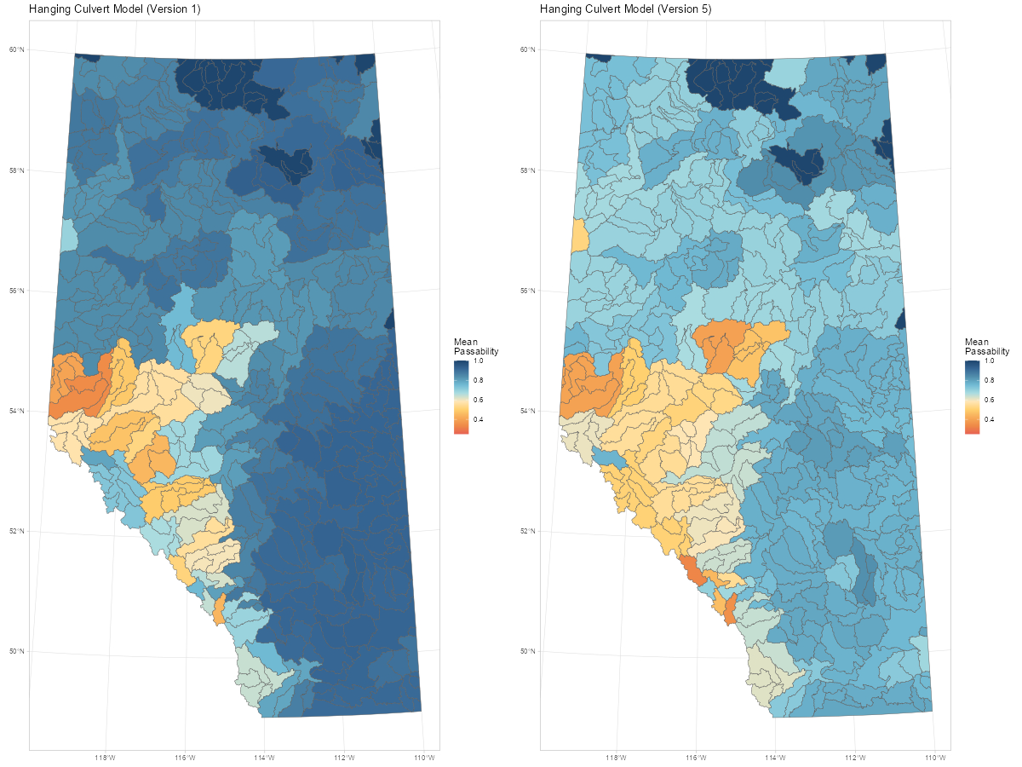
Stream Connectivity
Proposed Revision
      Met with folks in EPA to review the model and identify areas for investigation.
      Identified errors in filtering the culvert survey data. Previous version included surveys at arches, bridges, and temporary infrastructure.
      Using a single provincial model, we see similar pattens both in magnitude (after rescaling to favorability) and spatial distribution.
Original
Single Model

Slide 6
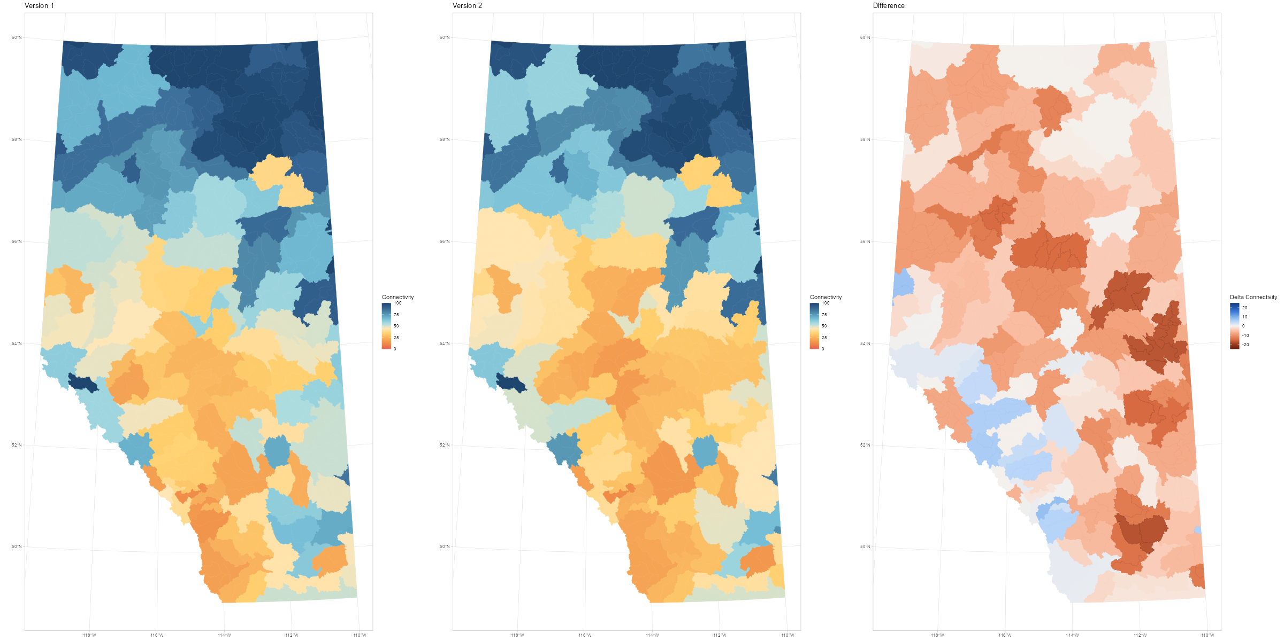
Stream Connectivity
Proposed Revision
      We recalculated the index for 2018 using the two hanging culvert models (previous version and proposed update).
      We also applied the culvert survey data based on the most recent information to remove biases introduced by additional ground truth data between the versions.
      Mostly small to moderate decreases in connectivity between versions. Some small increases in the foothills and rocky mountains.

Slide 7
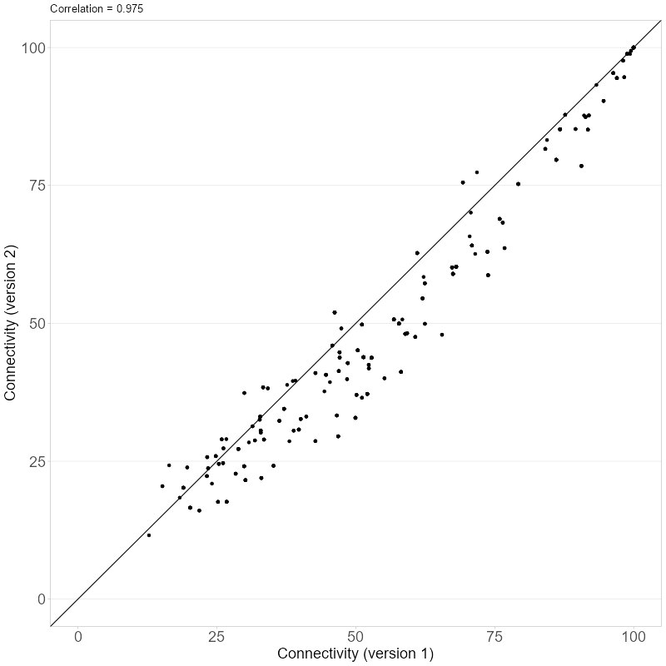
Stream Connectivity
Proposed Revision
      Higher correlation between the two versions (0.84 vs 0.98).
      19 of 422 watersheds had increases greater than 5% (max of 8%).
      189 watersheds had changes between -5% to 5%.
      214 watersheds had changes less than -5% (min -17%).
      On average, connectivity is lower in version 2 than version 1.

Slide 8
Stream Connectivity
Proposed Revision
      The new hanging culvert model is reasonable and has better model fit than the previous iteration.
      If the group agrees, this new model will be including in the update to the stream connectivity indicator.

Slide 9
Stream Connectivity
New documentation
      New technical documentation will be created based on the proposed update.
      A change log will be created to document how version 1 and version 2 of the indicator differ.
        Available for internal uses.
        Highlights changes in the hanging culvert model.
        Highlights the impact of new ground truth surveys on the indicator.

Slide 10
Discussion

