Slide 1
Wetland Advisory Group
June 26, 2025

Slide 2
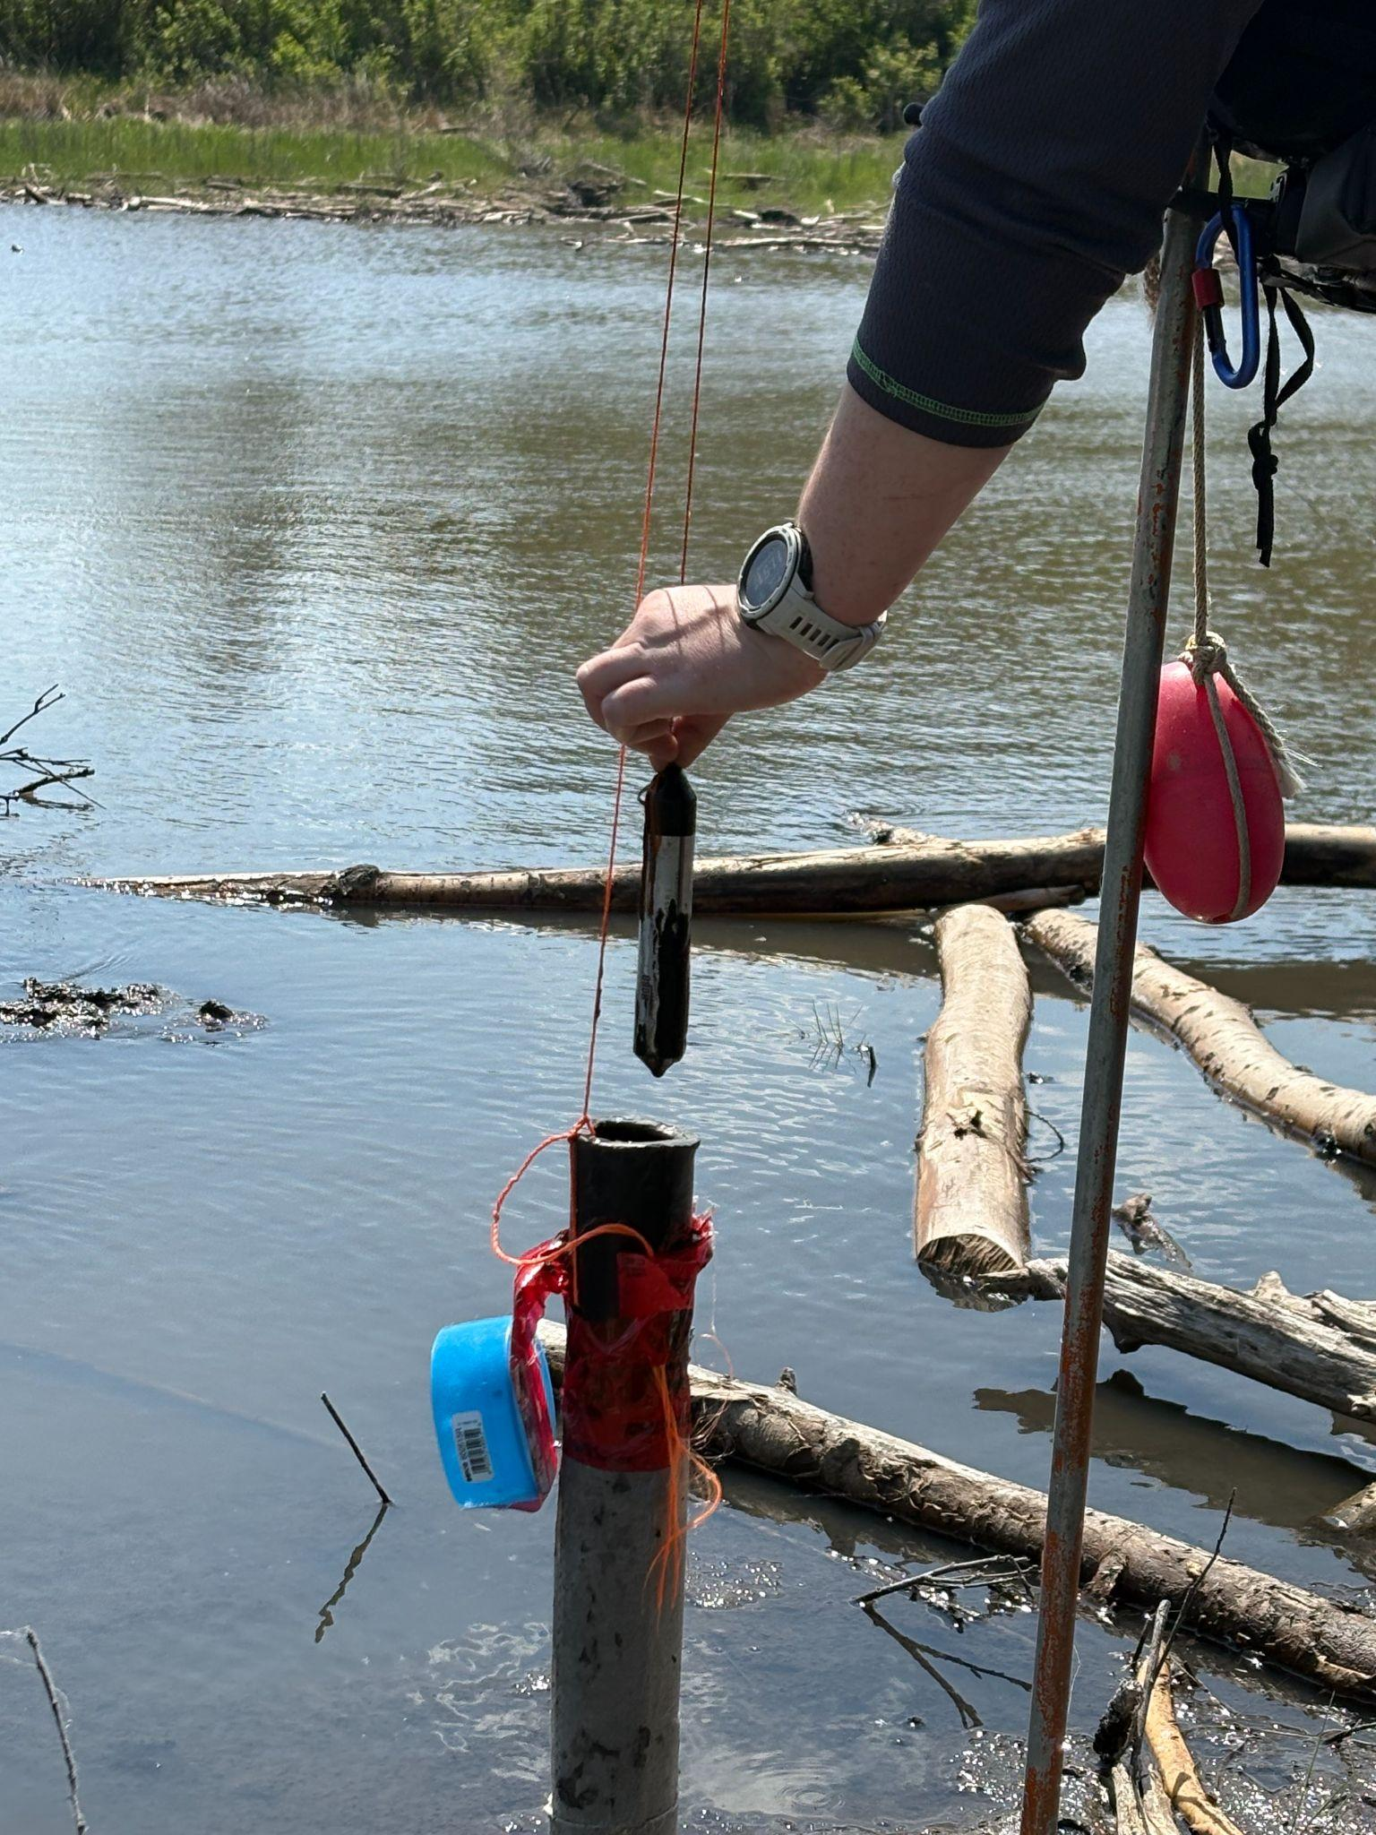
Agenda
1. ABMI Wetland monitoring 2025-26
2. WAG year at a glance
3. WAG member updates
4. HydroPatterns: provincial coarse filter indicator results
5. Indigenous engagement update
6. Wrap up & review

Slide 3
Wetland monitoring 2025-26
This year, we will continue to collaboratively build a provincial-scale wetland monitoring program
Coordination / collaboration is necessary to meet Alberta wetland information needs
Work with MER (EPA) project team to develop study design and prioritize indicators
2025 Field work underway (HydroPatterns validation, Ecosite)
  Wildfire challenges!
Assess pilot field efforts (feasibility, accuracy, ecological relevance)
  Did we mention wildfire challenges?

Slide 4
WAG at a glance
June
Year at a glance
HydroPatterns results
Indigenous engagement update
September/ October
ABMI 2025 Field update
MER update
Monitoring program design update
February
Wetland data and research releases
Looking ahead to 2026

Slide 5
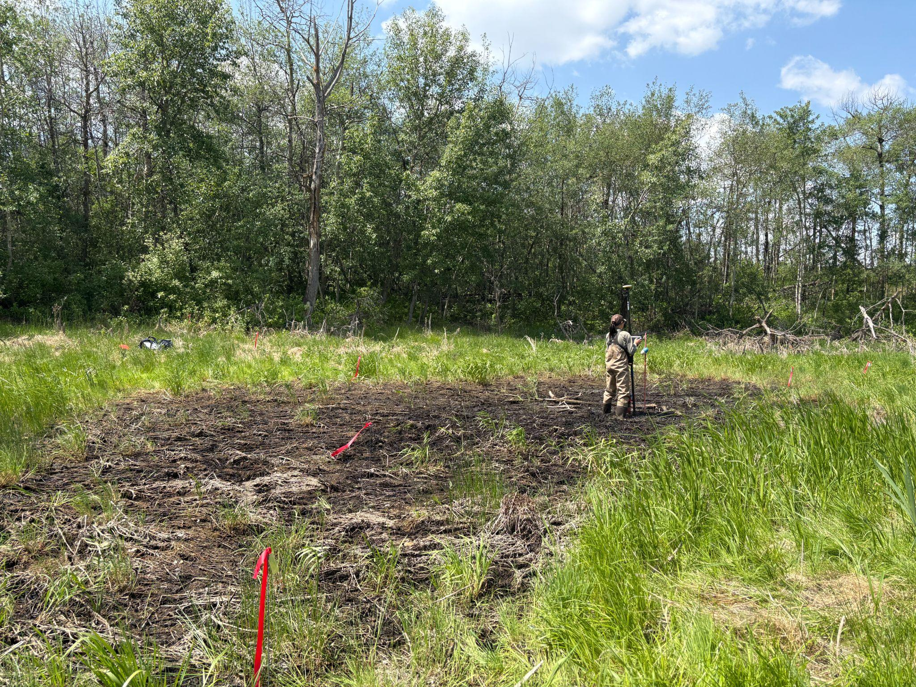
Any Wetland Updates to Share?
Open Floor
Field plans/updates?
Analysis/reports?

Slide 6
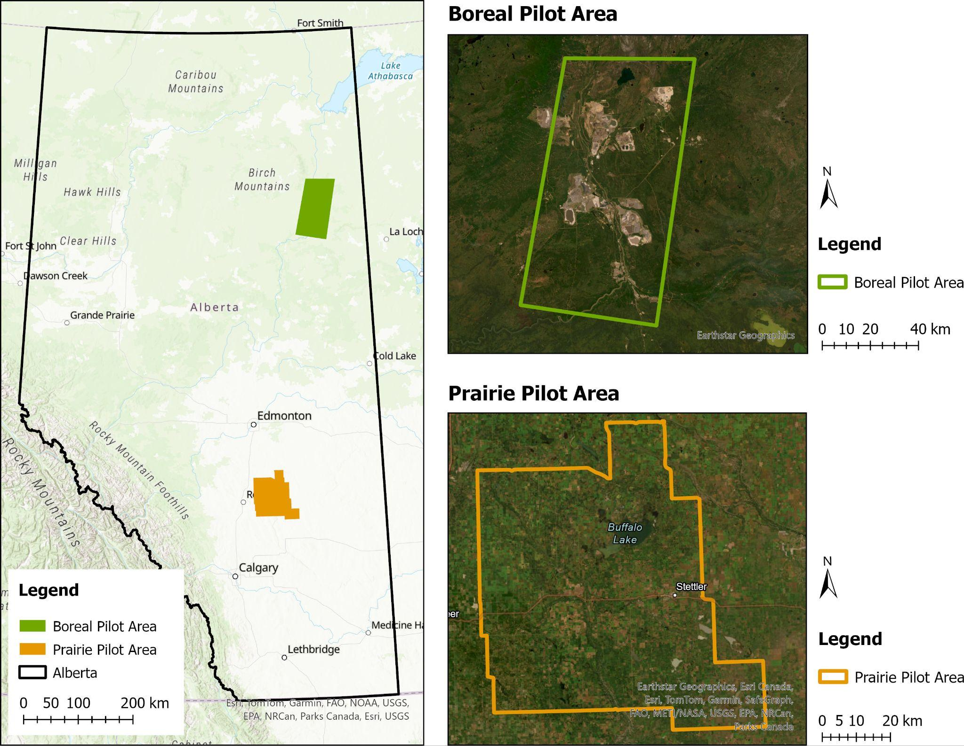
HydroPatterns Pilot: Background Review
Pilot project objective: Develop a lentic open surface water dynamics dataset for enhanced wetland mapping and long-term monitoring
Lentic open water features: lakes, ponds, open water wetlands, dugouts, and reservoirs
Two pilot areas:
  Boreal (5,000 km²)
  Prairie Parkland (6000 km²)

Slide 7
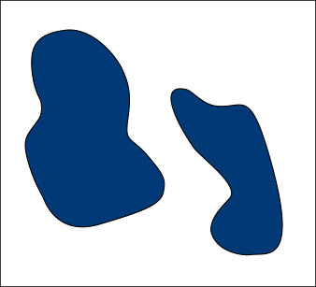
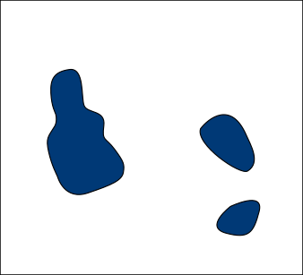
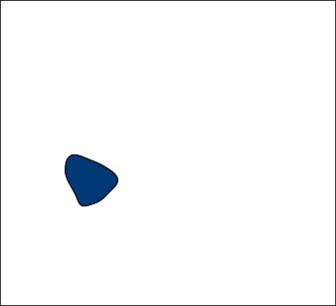
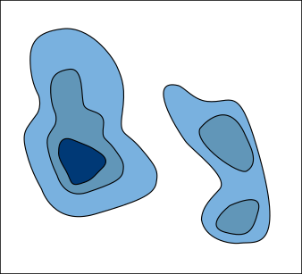
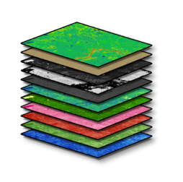

HydroPatterns Pilot: Methods Review
First: Open surface water mapping at each time step
Then: Combine maps into one dataset - HydroPatterns
2020 – 2023 growing seasons (i.e. May – October)
Water
Non-water
…
1st month
2nd month
N^{th} month
Permanent water
Semi-permanent water
Seasonal water
Optical (Sentinel-2), Radar (Sentinel-1) and Terrain (DEM)
Pixel-based, machine learning (e.g., Gradient Boosting Trees, Random Forest)
Permanent non-water

Slide 8
HydroPatterns Pilot: Methods Review
Validation data used for assessing accuracy:
Pilot Area | Validation dataset | Format | Collection method | Accuracy assessment method | Source
Boreal | ABMI validation labels | Polygon | Manual interpretation of May 2020 Planet Basemap | Pixel-based | ABMI
Prairie | DUC validation labels | Polygon | Interpretation from stereophotos on May 14th 2020 | Pixel-based | DUC
 | ABMI wetland field samples | Point | Fieldwork implementation in July 2023 | Point-based | ABMI

Slide 9
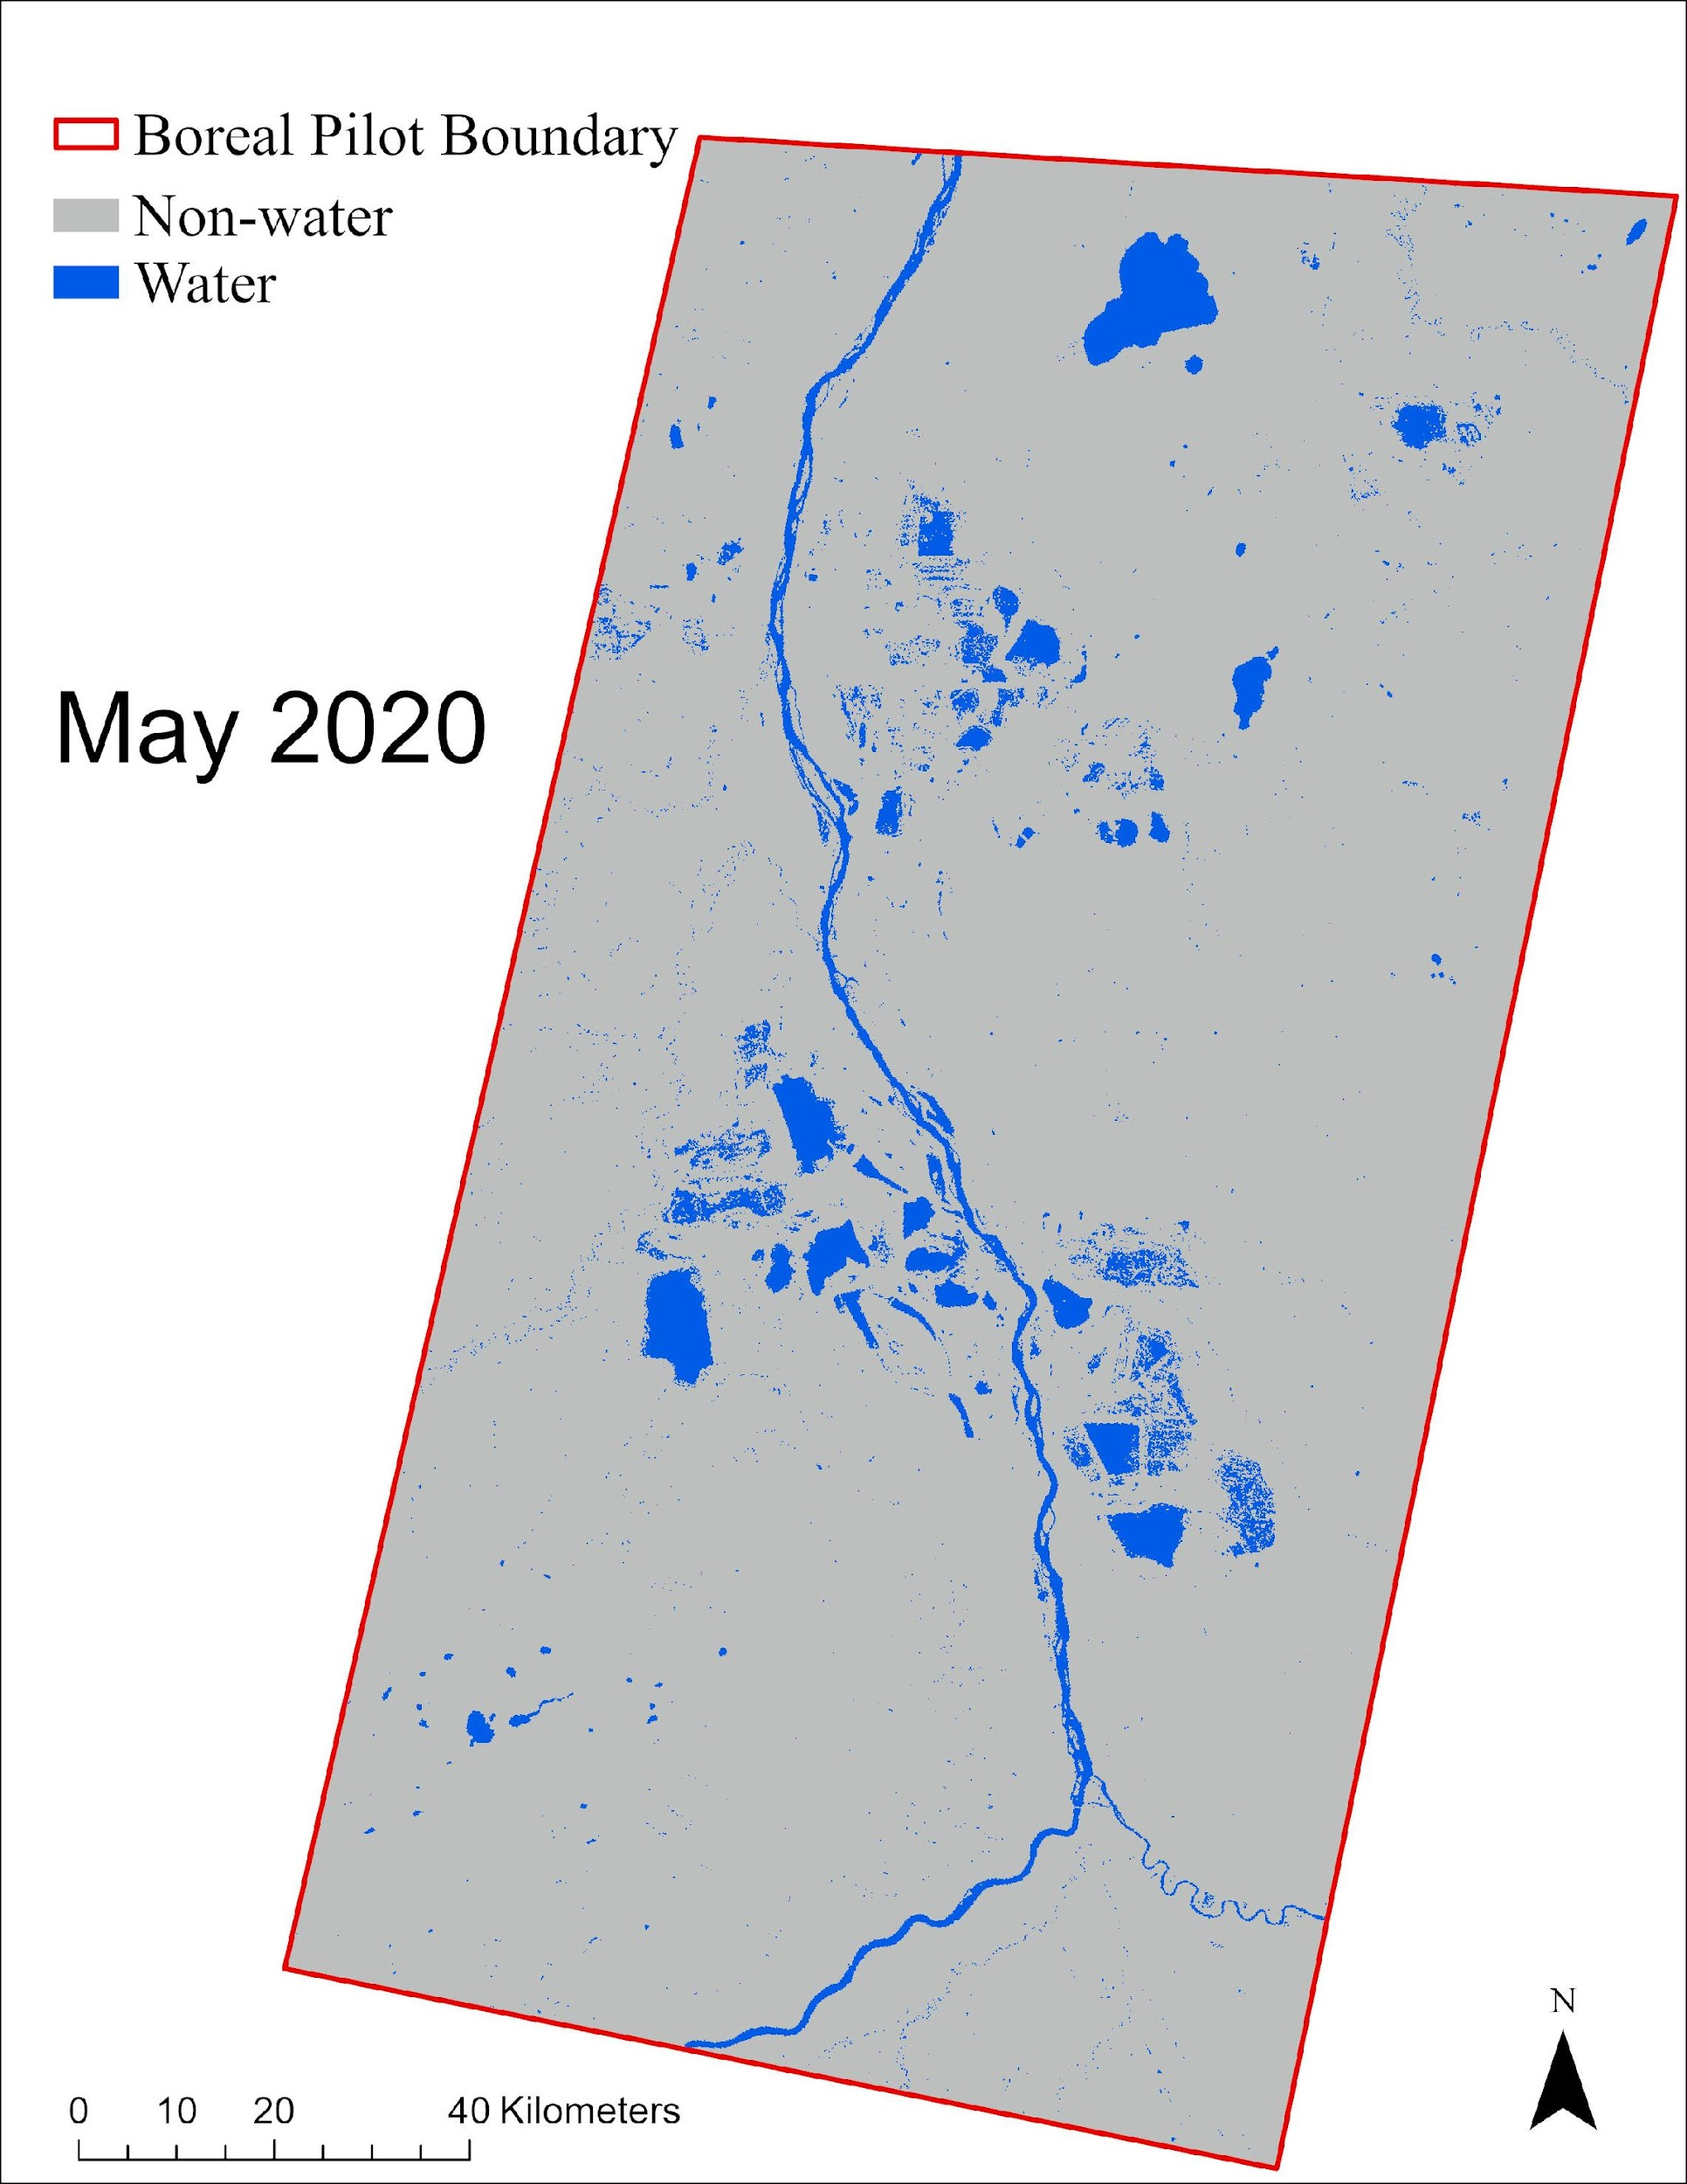
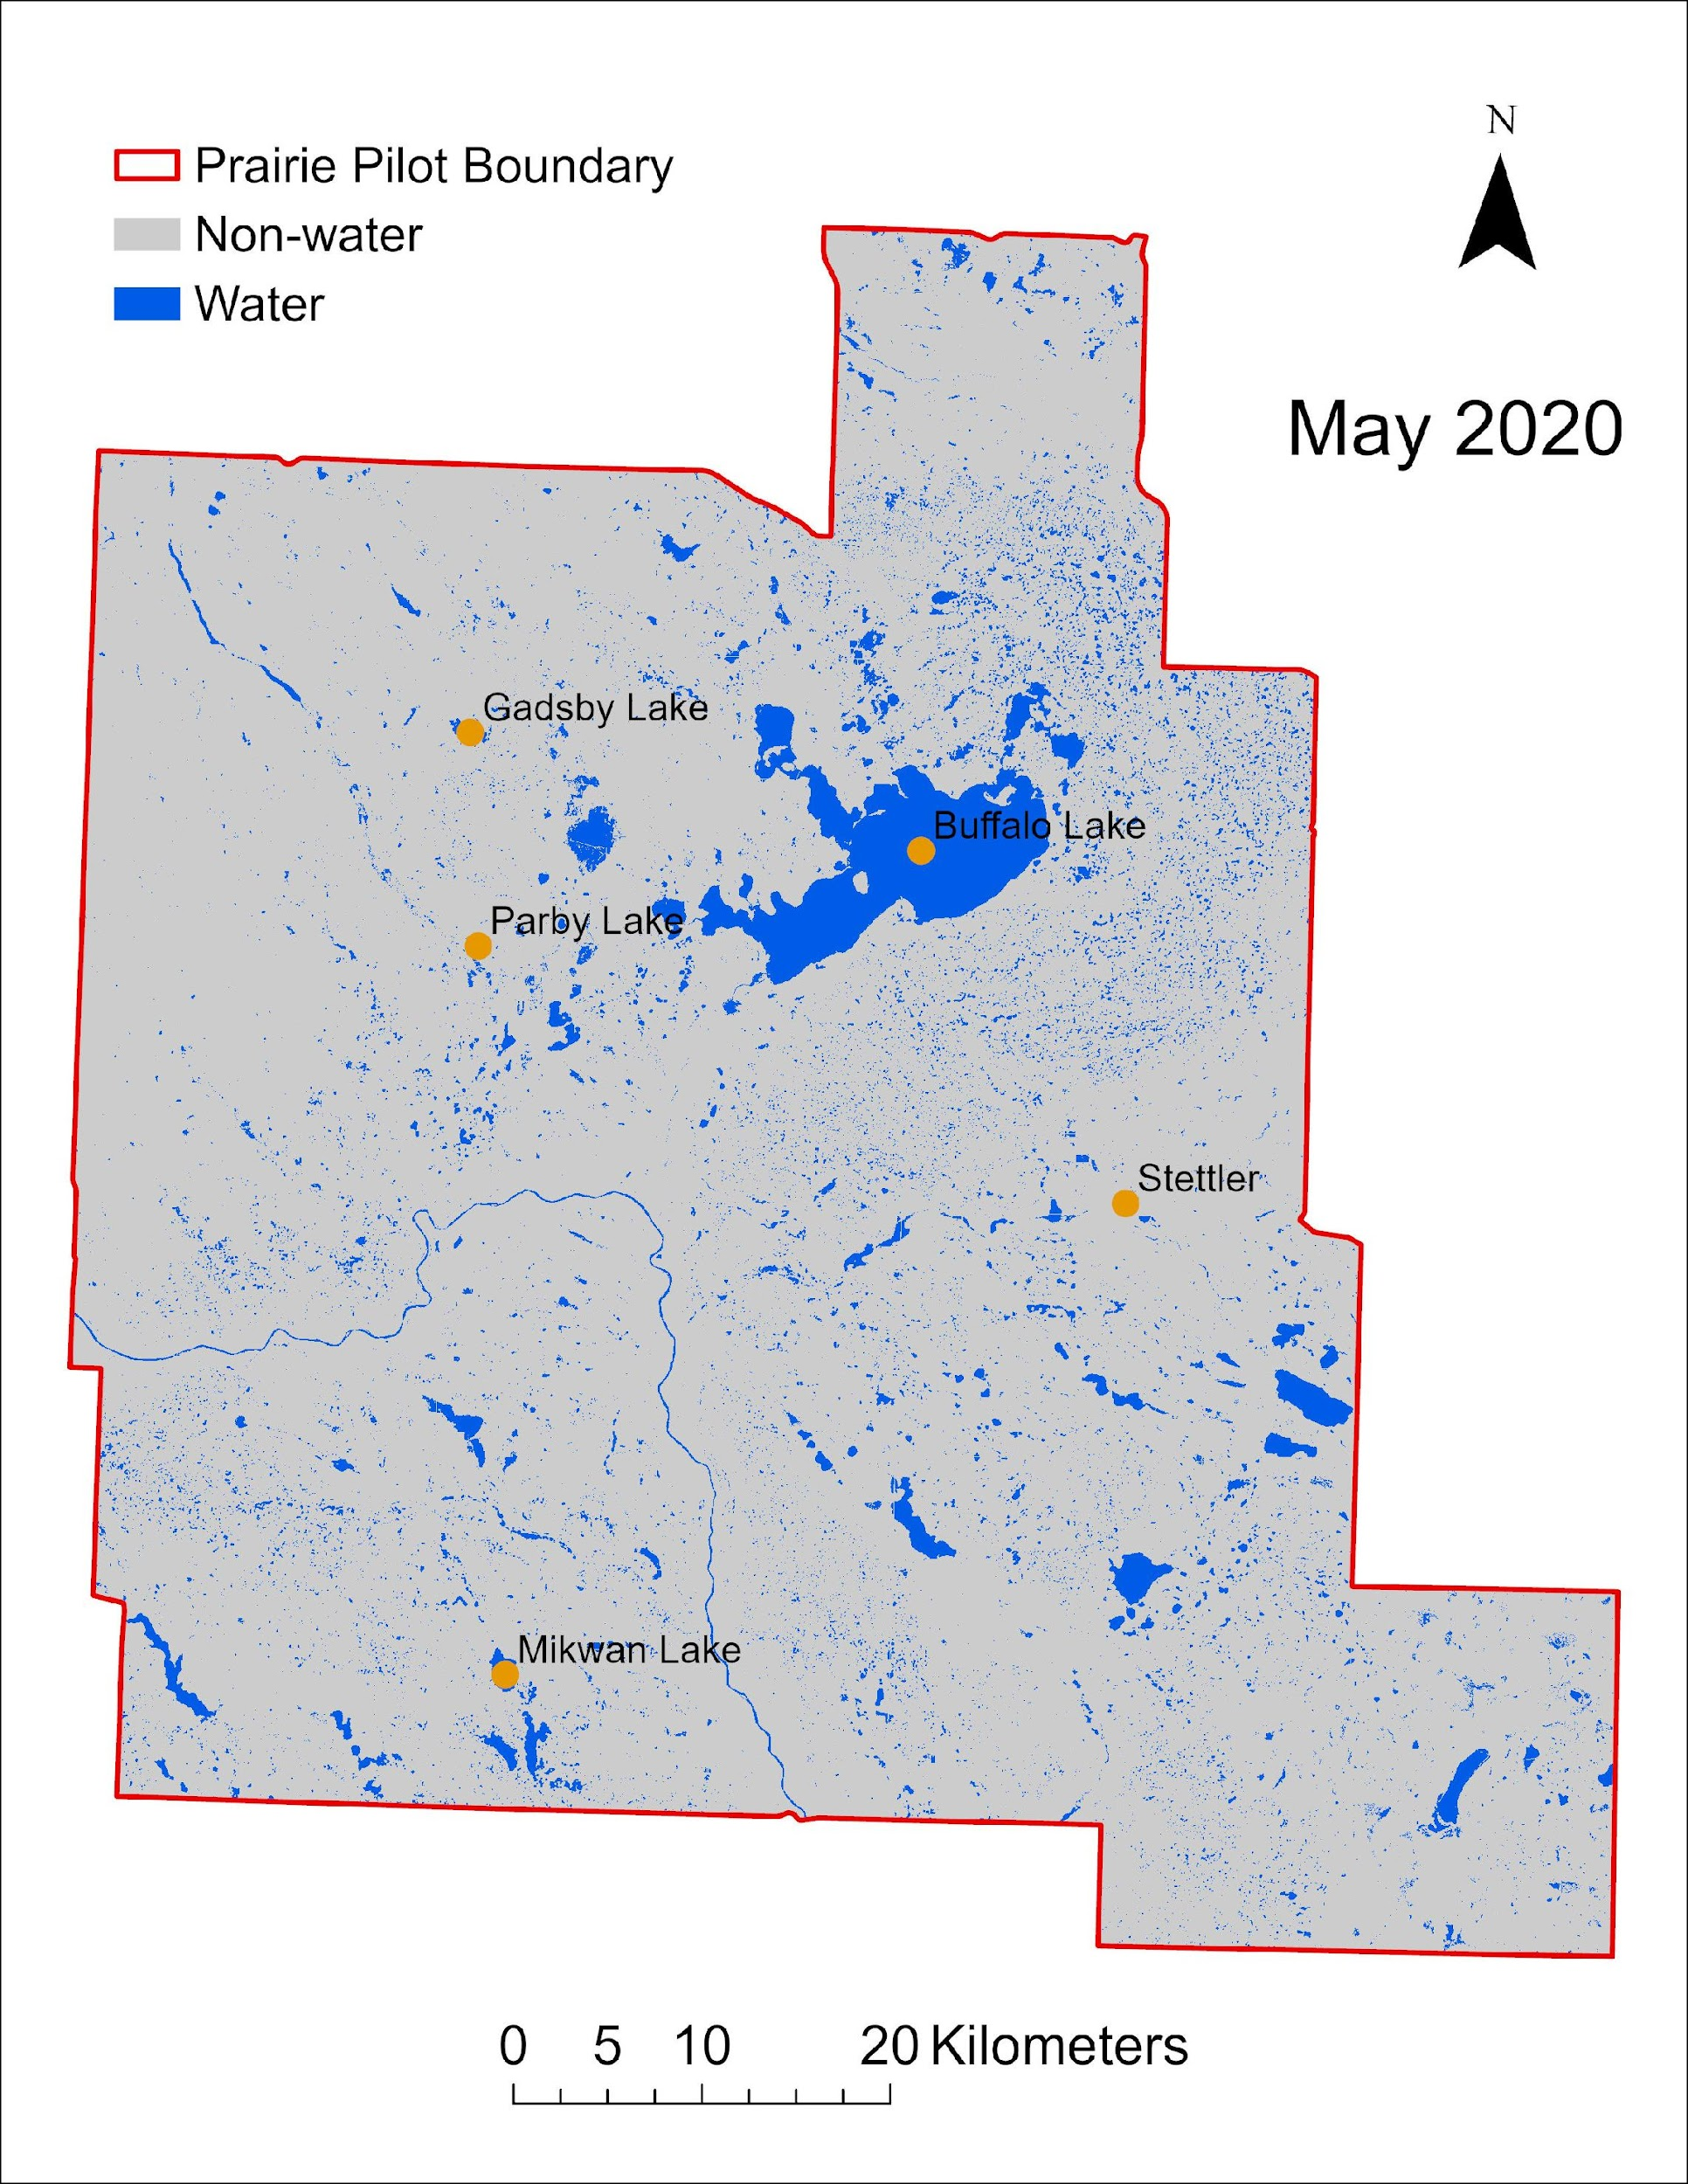
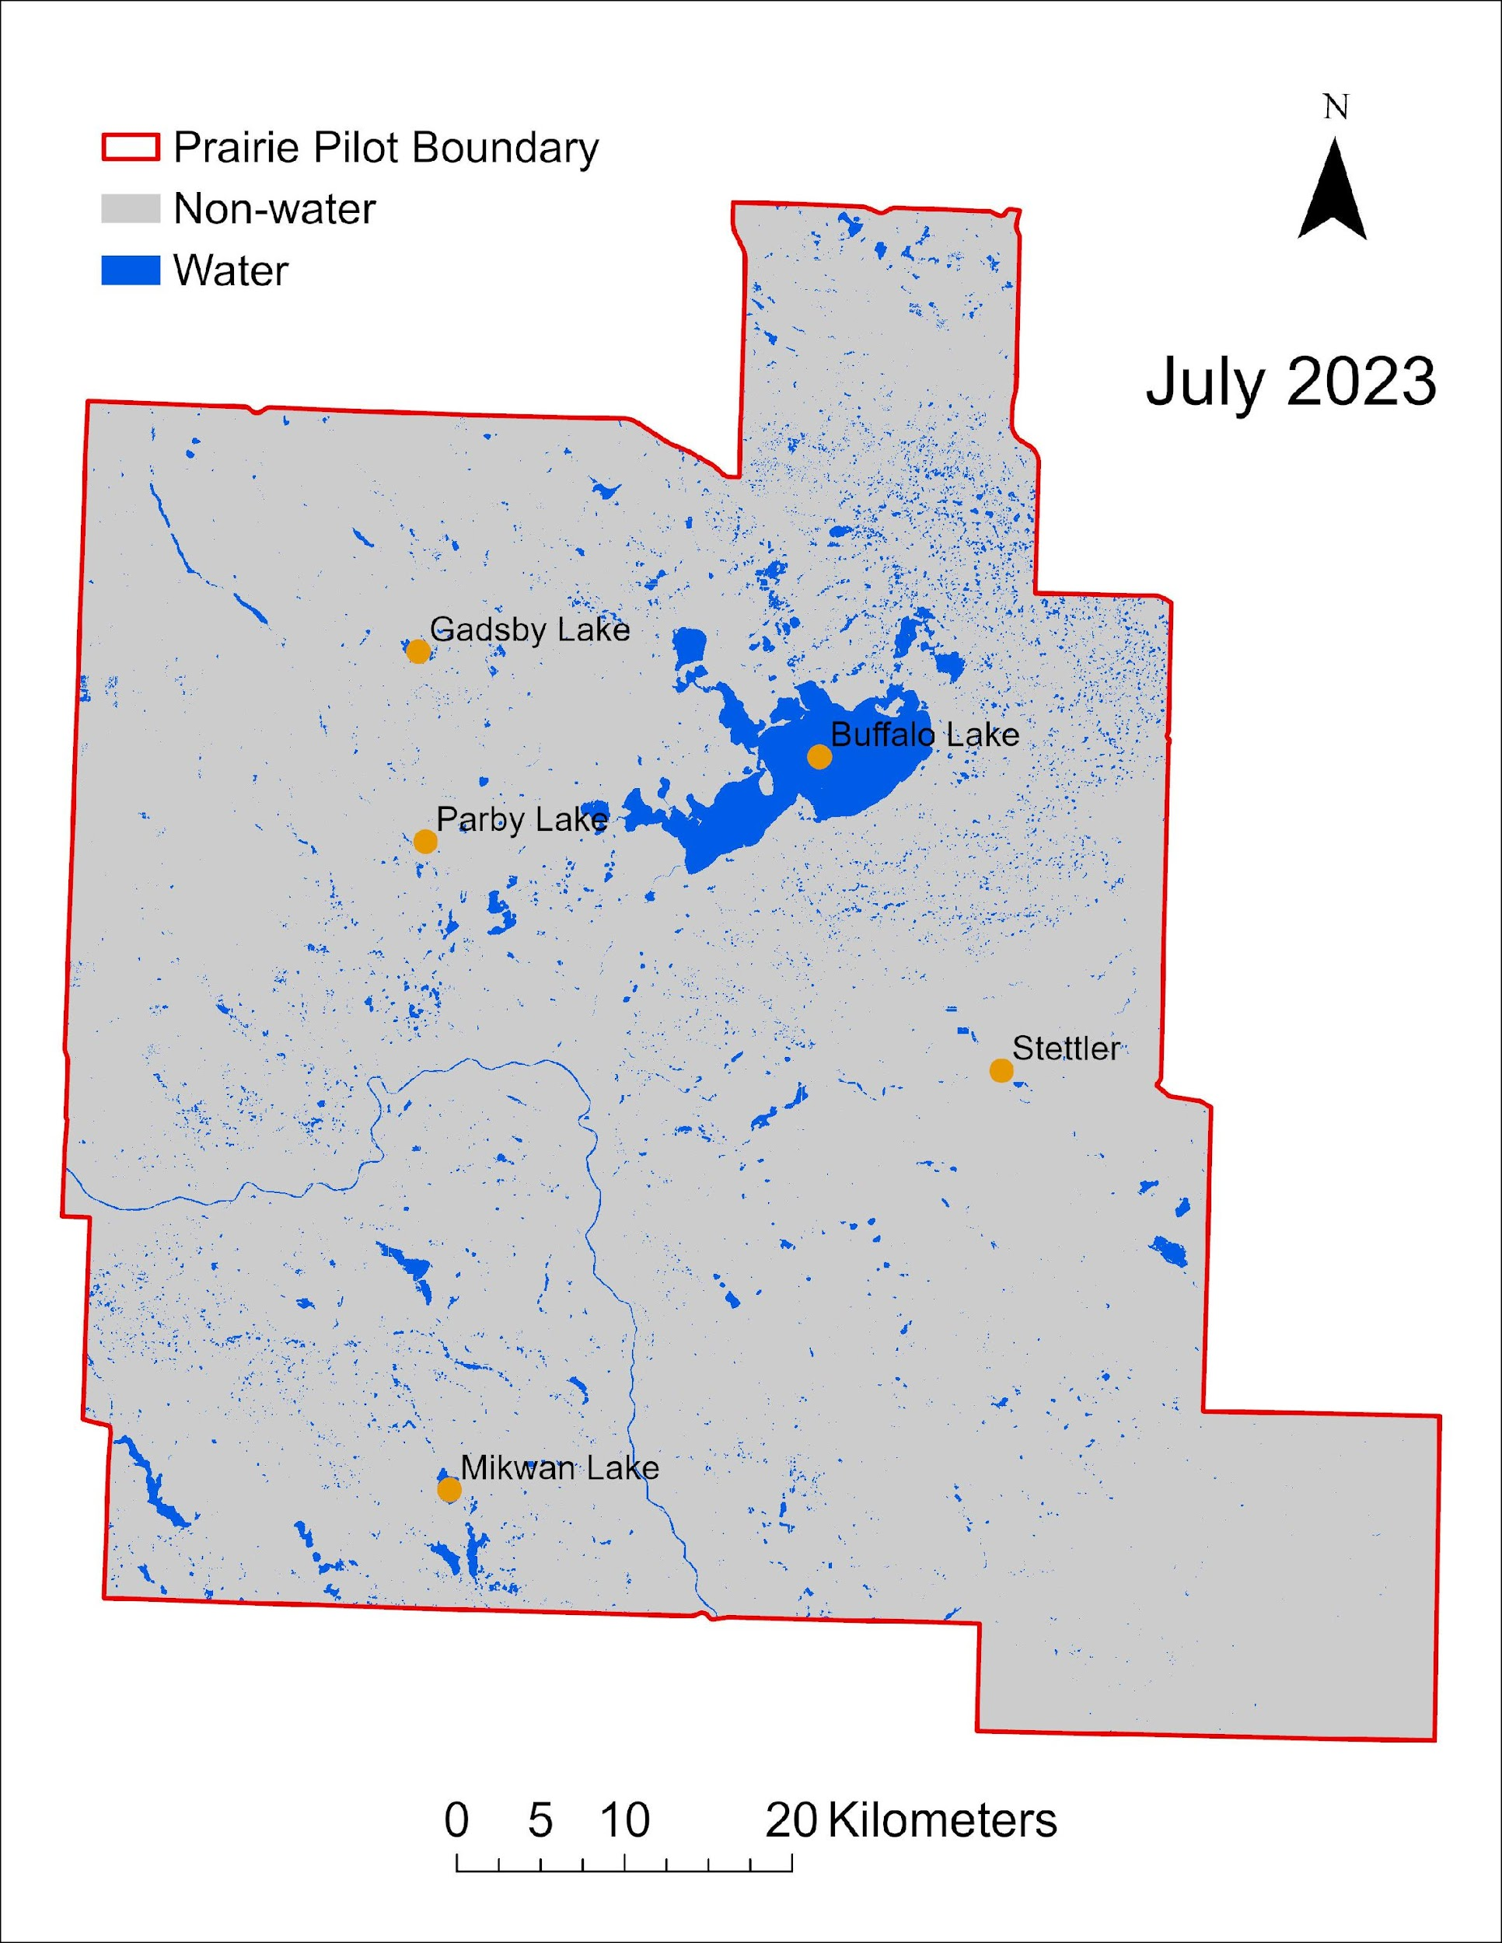
HydroPatterns Pilot: Results
Open surface water was detected with >90% overall accuracy (OA)
OA = 99.6%
OA = 98.8%
OA = 90.0%

Slide 10
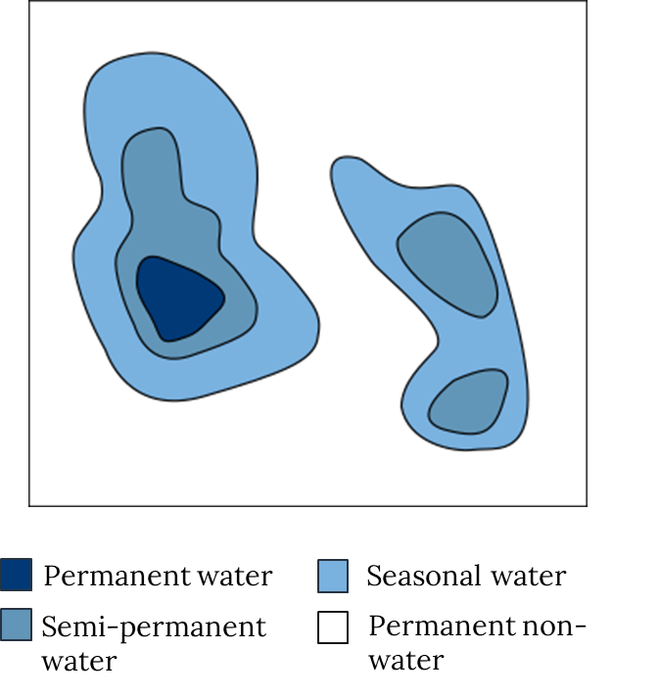
HydroPatterns Pilot: Results
HydroPatterns Outputs
Monthly open surface water maps for each year
Seasonal inundation frequency maps for spring, summer, and fall
Annual inundation frequency maps
Multi-annual average inundation frequency map
Change detection in total open surface water extent from month to month
Inundation frequency is defined as the percentage of time each pixel is flooded.

Slide 11
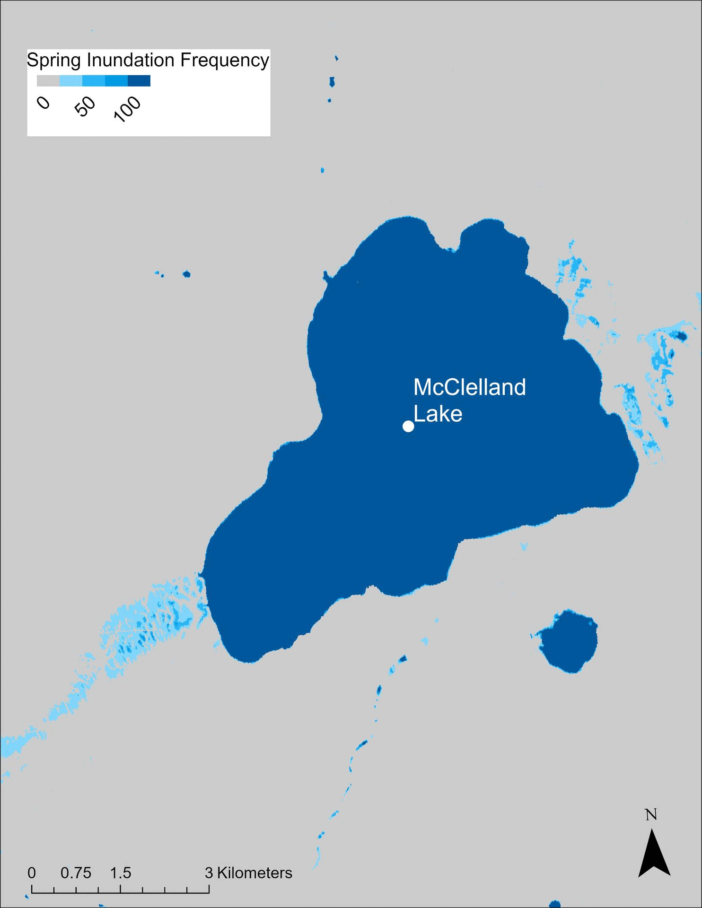
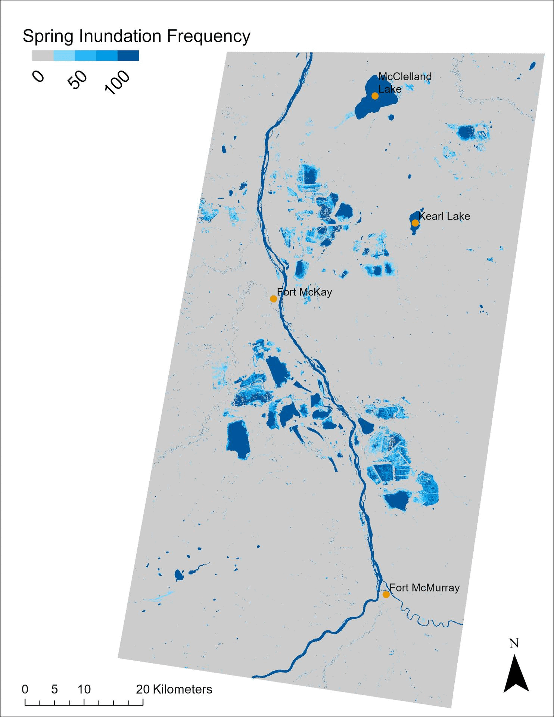

HydroPatterns Pilot: Results
Boreal Pilot Area
Detailed view of McClelland Lake Wetland Complexes
Seasonal Inundation Frequency Maps
Annual Inundation Frequency Maps

Slide 12
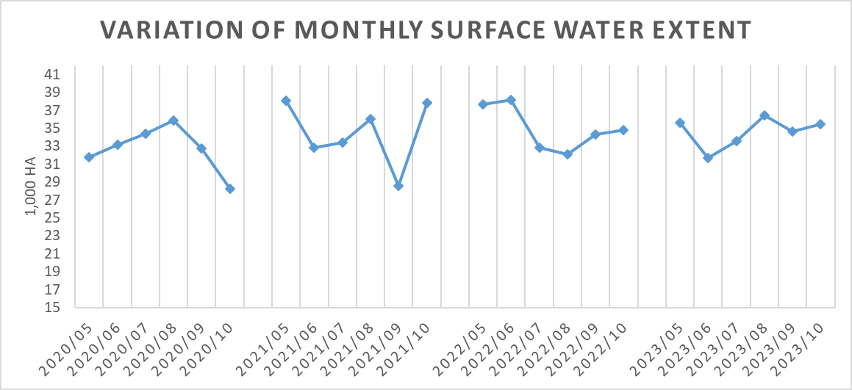
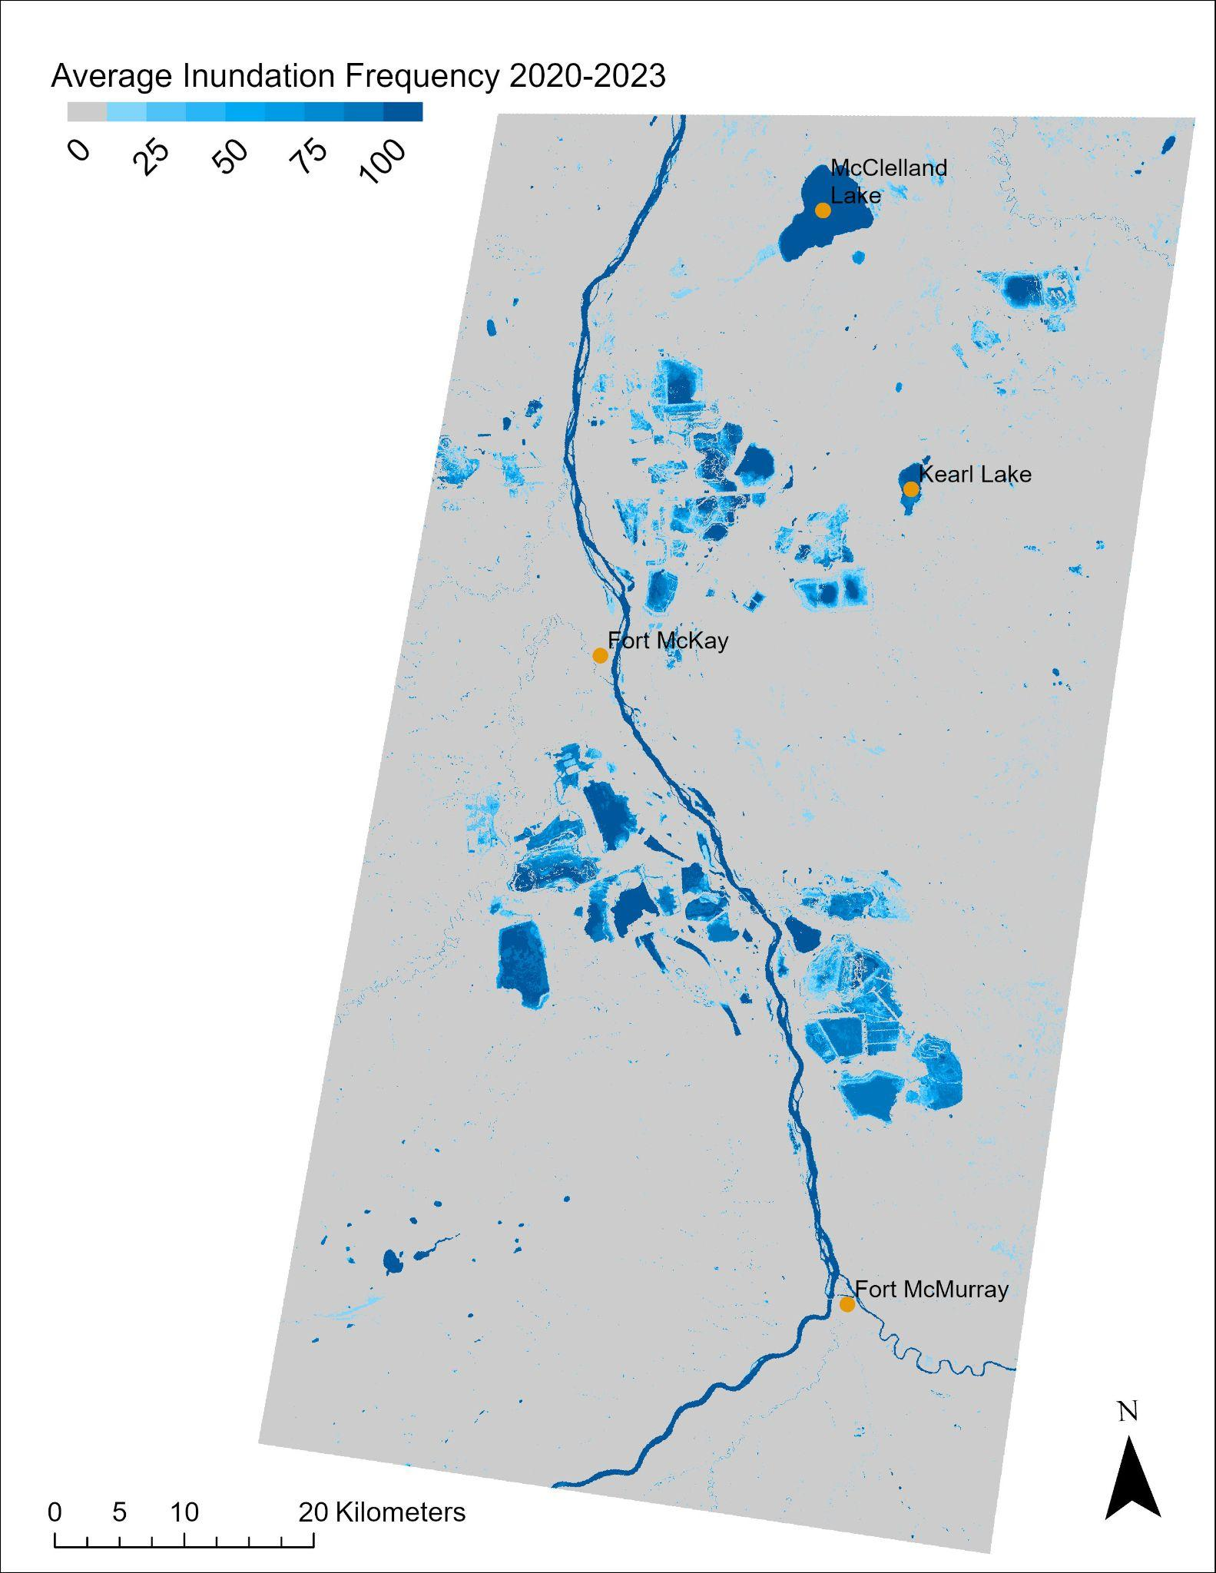
HydroPatterns Pilot: Results
Boreal Pilot Area
Multi-year Average Inundation Frequency Map
Class | Percent coverage
Permanent water | 3%
Non-permanent water | 6%
Permanent land | 91%
Note: Surface water extent in both lotic (flowing) and lentic habitats were mapped, but only lentic surface water maps were validated

Slide 13
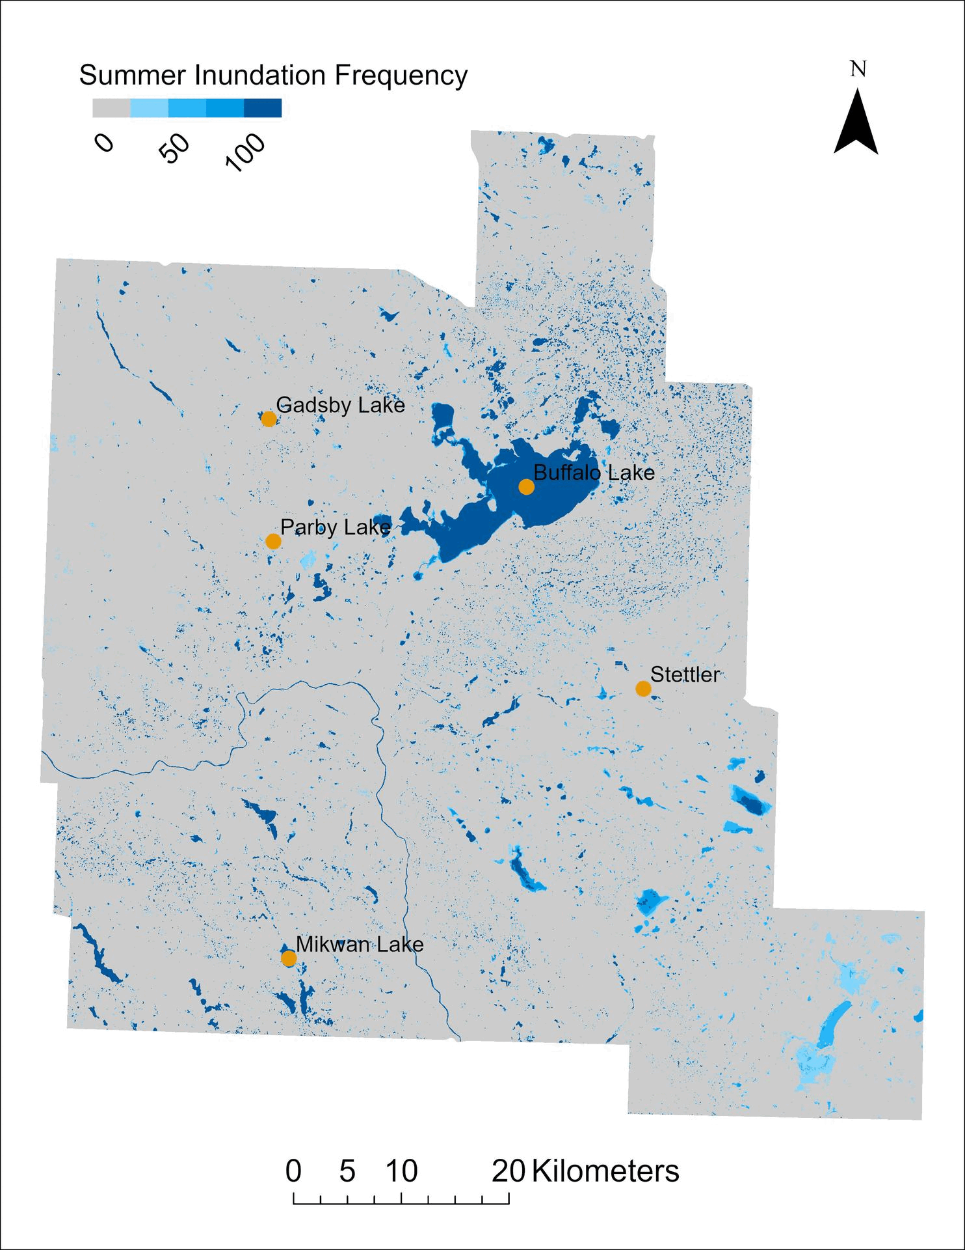

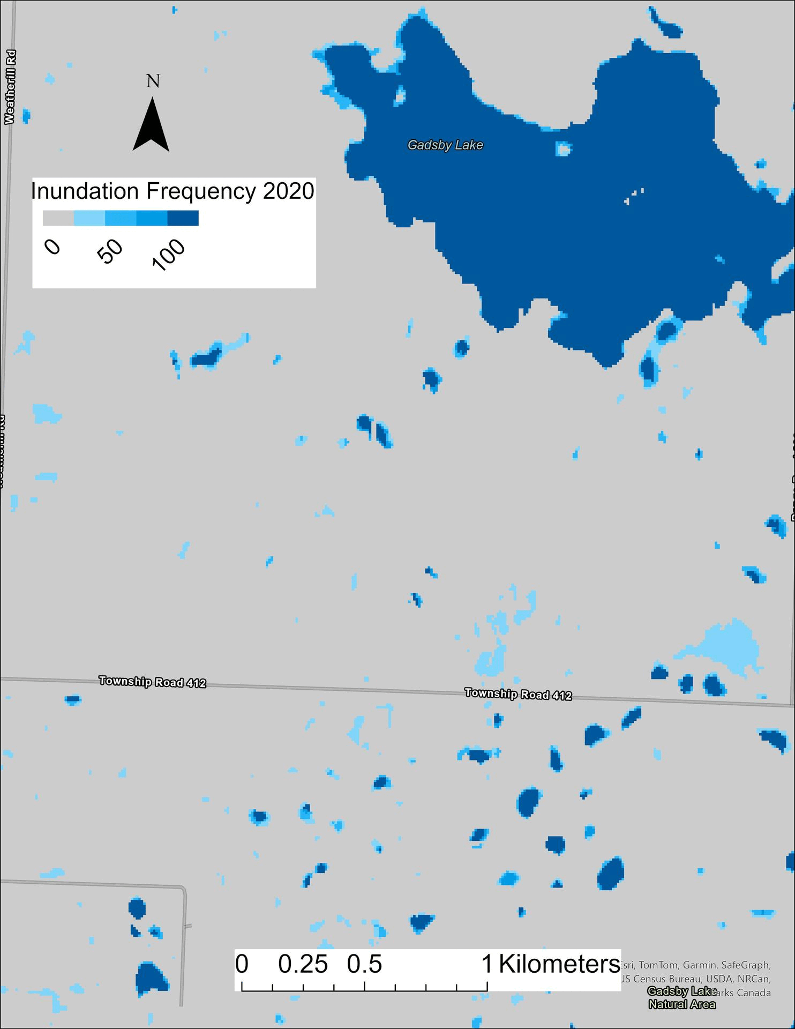
HydroPatterns Pilot: Results
Prairie Parkland Pilot Area
Detailed view of Gadsby Lake Natural Area
Seasonal Inundation Frequency Maps
Annual Inundation Frequency Maps

Slide 14
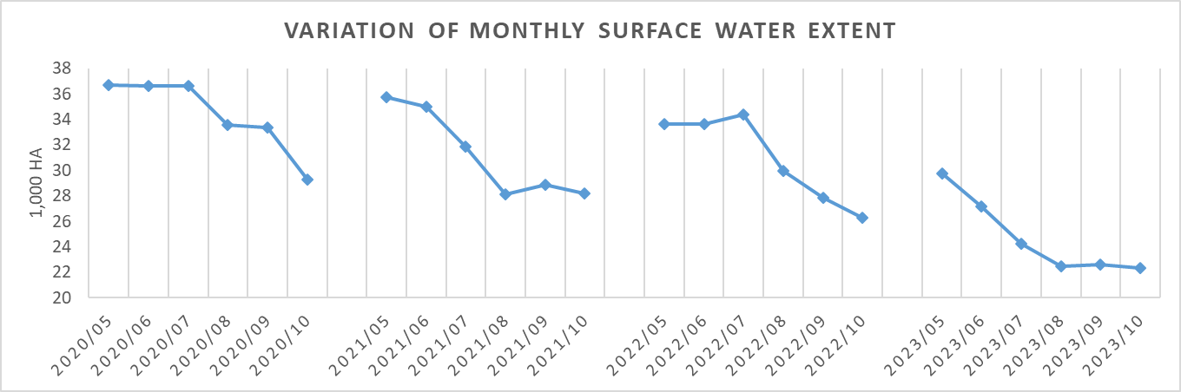
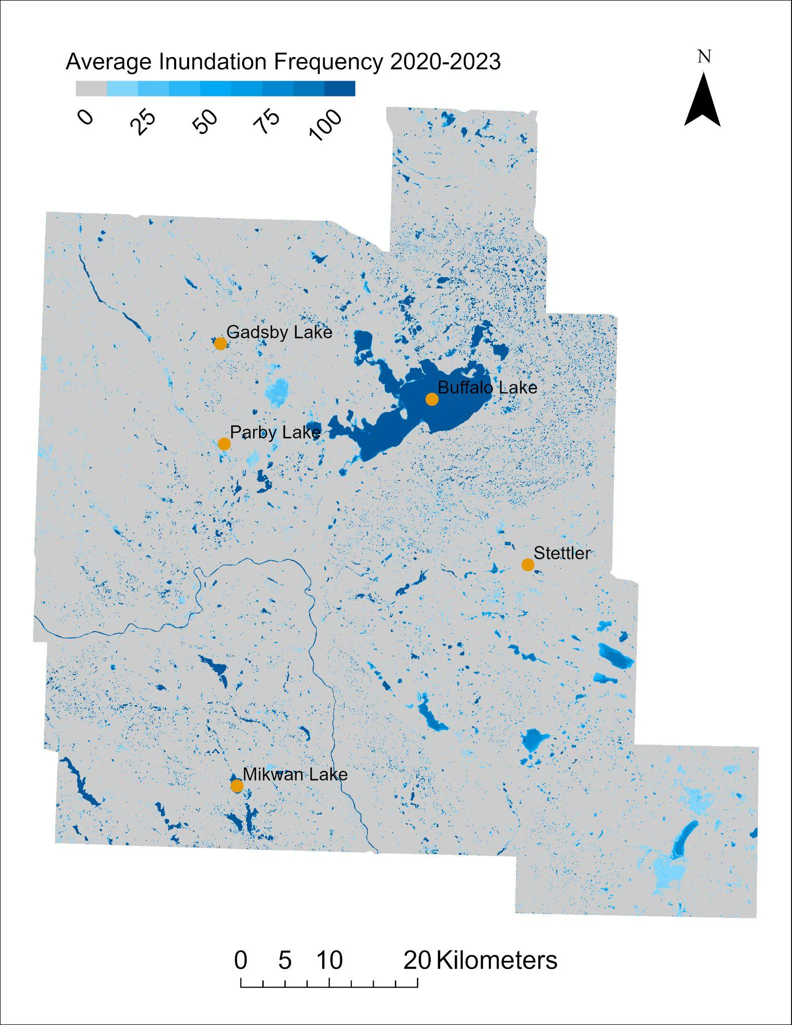
HydroPatterns Pilot: Results
Prairie Parkland Pilot Area
Multi-year Average Inundation Frequency Map
Class | Percent coverage
Permanent water | 4%
Non-permanent water | 7%
Permanent land | 89%
Note: Surface water extent in both lotic (flowing) and lentic habitats were mapped, but only lentic surface water maps were validated

Slide 15
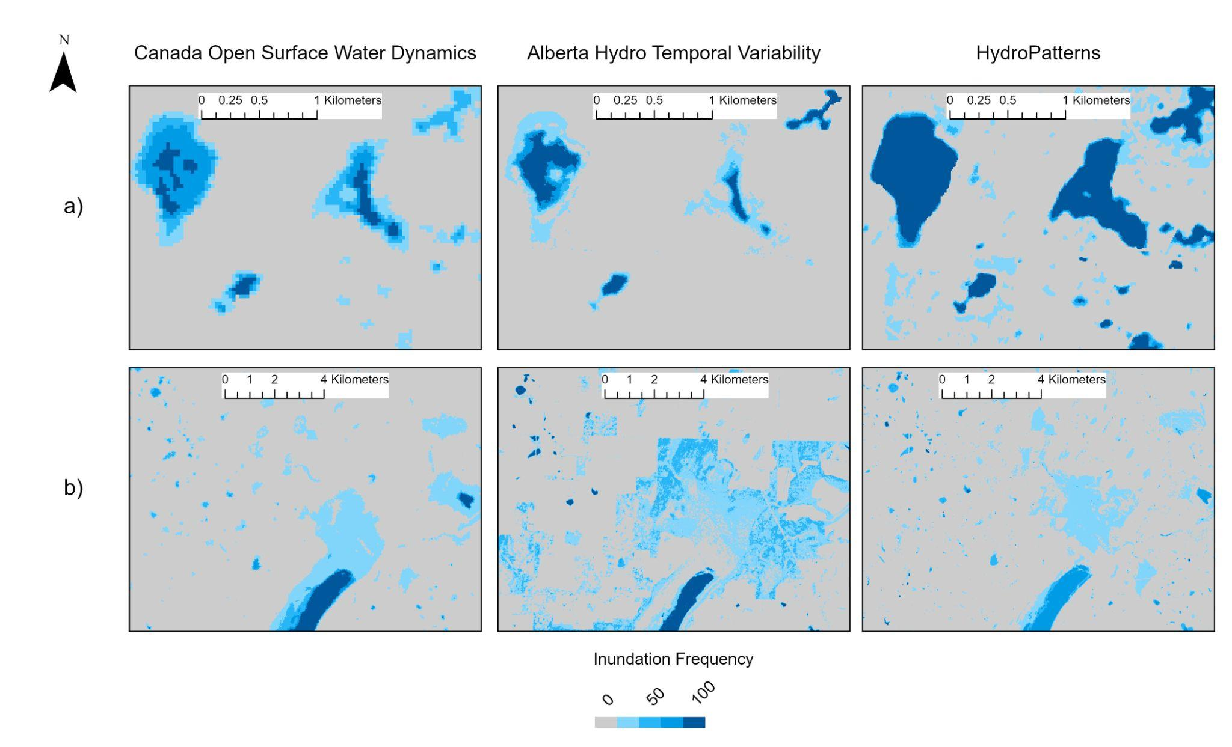
HydroPatterns Pilot: Results
Prairie Parkland Pilot Area
Canada Open Surface Water Dynamics
Alberta Hydro Temporal Variability
New HydroPatterns
Olthof & Rainville, 2022
ABMI, 2017
ABMI, 2025
HydroPatterns: enhanced edge detection, captures more non-permanent water features than other products (higher spatial and temporal resolutions)

Slide 16
HydroPatterns Pilot: Limitations & Next Steps
Limitations
HydroPatterns products do not currently distinguish between open surface water in lotic (flowing) and lentic (standing) habitats.
  Validation of results for lotic habitats was not conducted in this project.
Inundated vegetation is not currently accounted for in the workflow or analysis.
Next Steps
Further validation with water level logger data and field observations being collected in the Prairie Parkland pilot area this summer
Addition of HydroPeriod to the ABMI Wetland Atlas (late 2025)
Continue to explore opportunities to scale this to larger areas (province-wide??)
Hope to include new type of SAR anticipated to be available soon (L-band, freely-available)

Slide 17
HydroPatterns Pilot: Outcomes Discussion
Useful ways to be summarize temporal data for your needs?
  E.g., over seasons, year by year, over multiple years, etc.
Applications for data?
  What would you envision being able to capture, or want to capture with data like this?

Slide 18
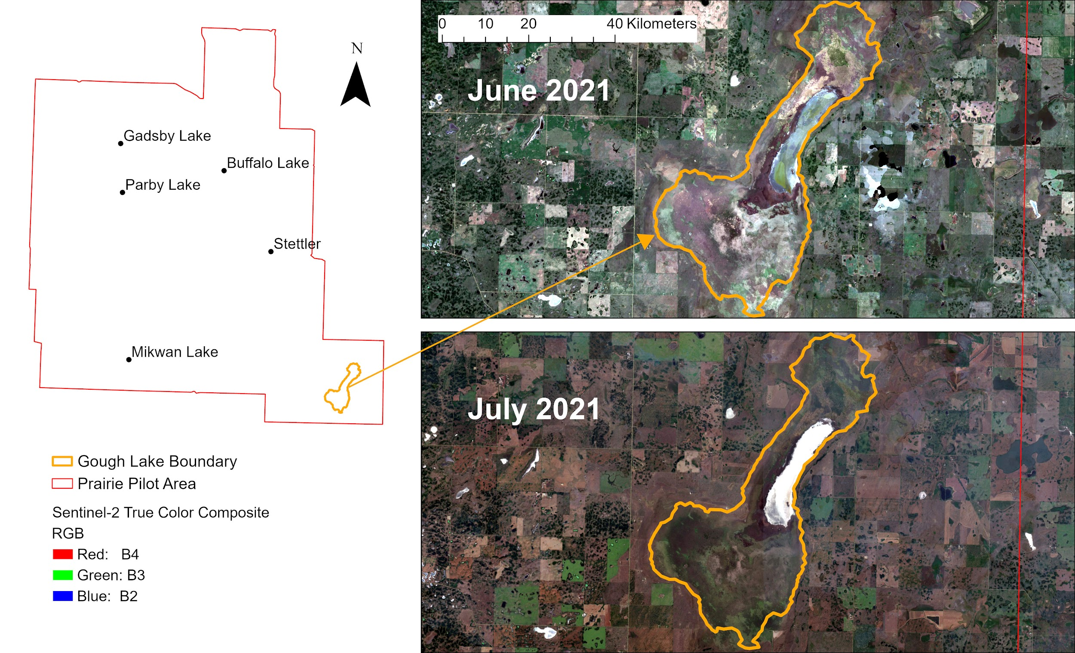

Slide 19
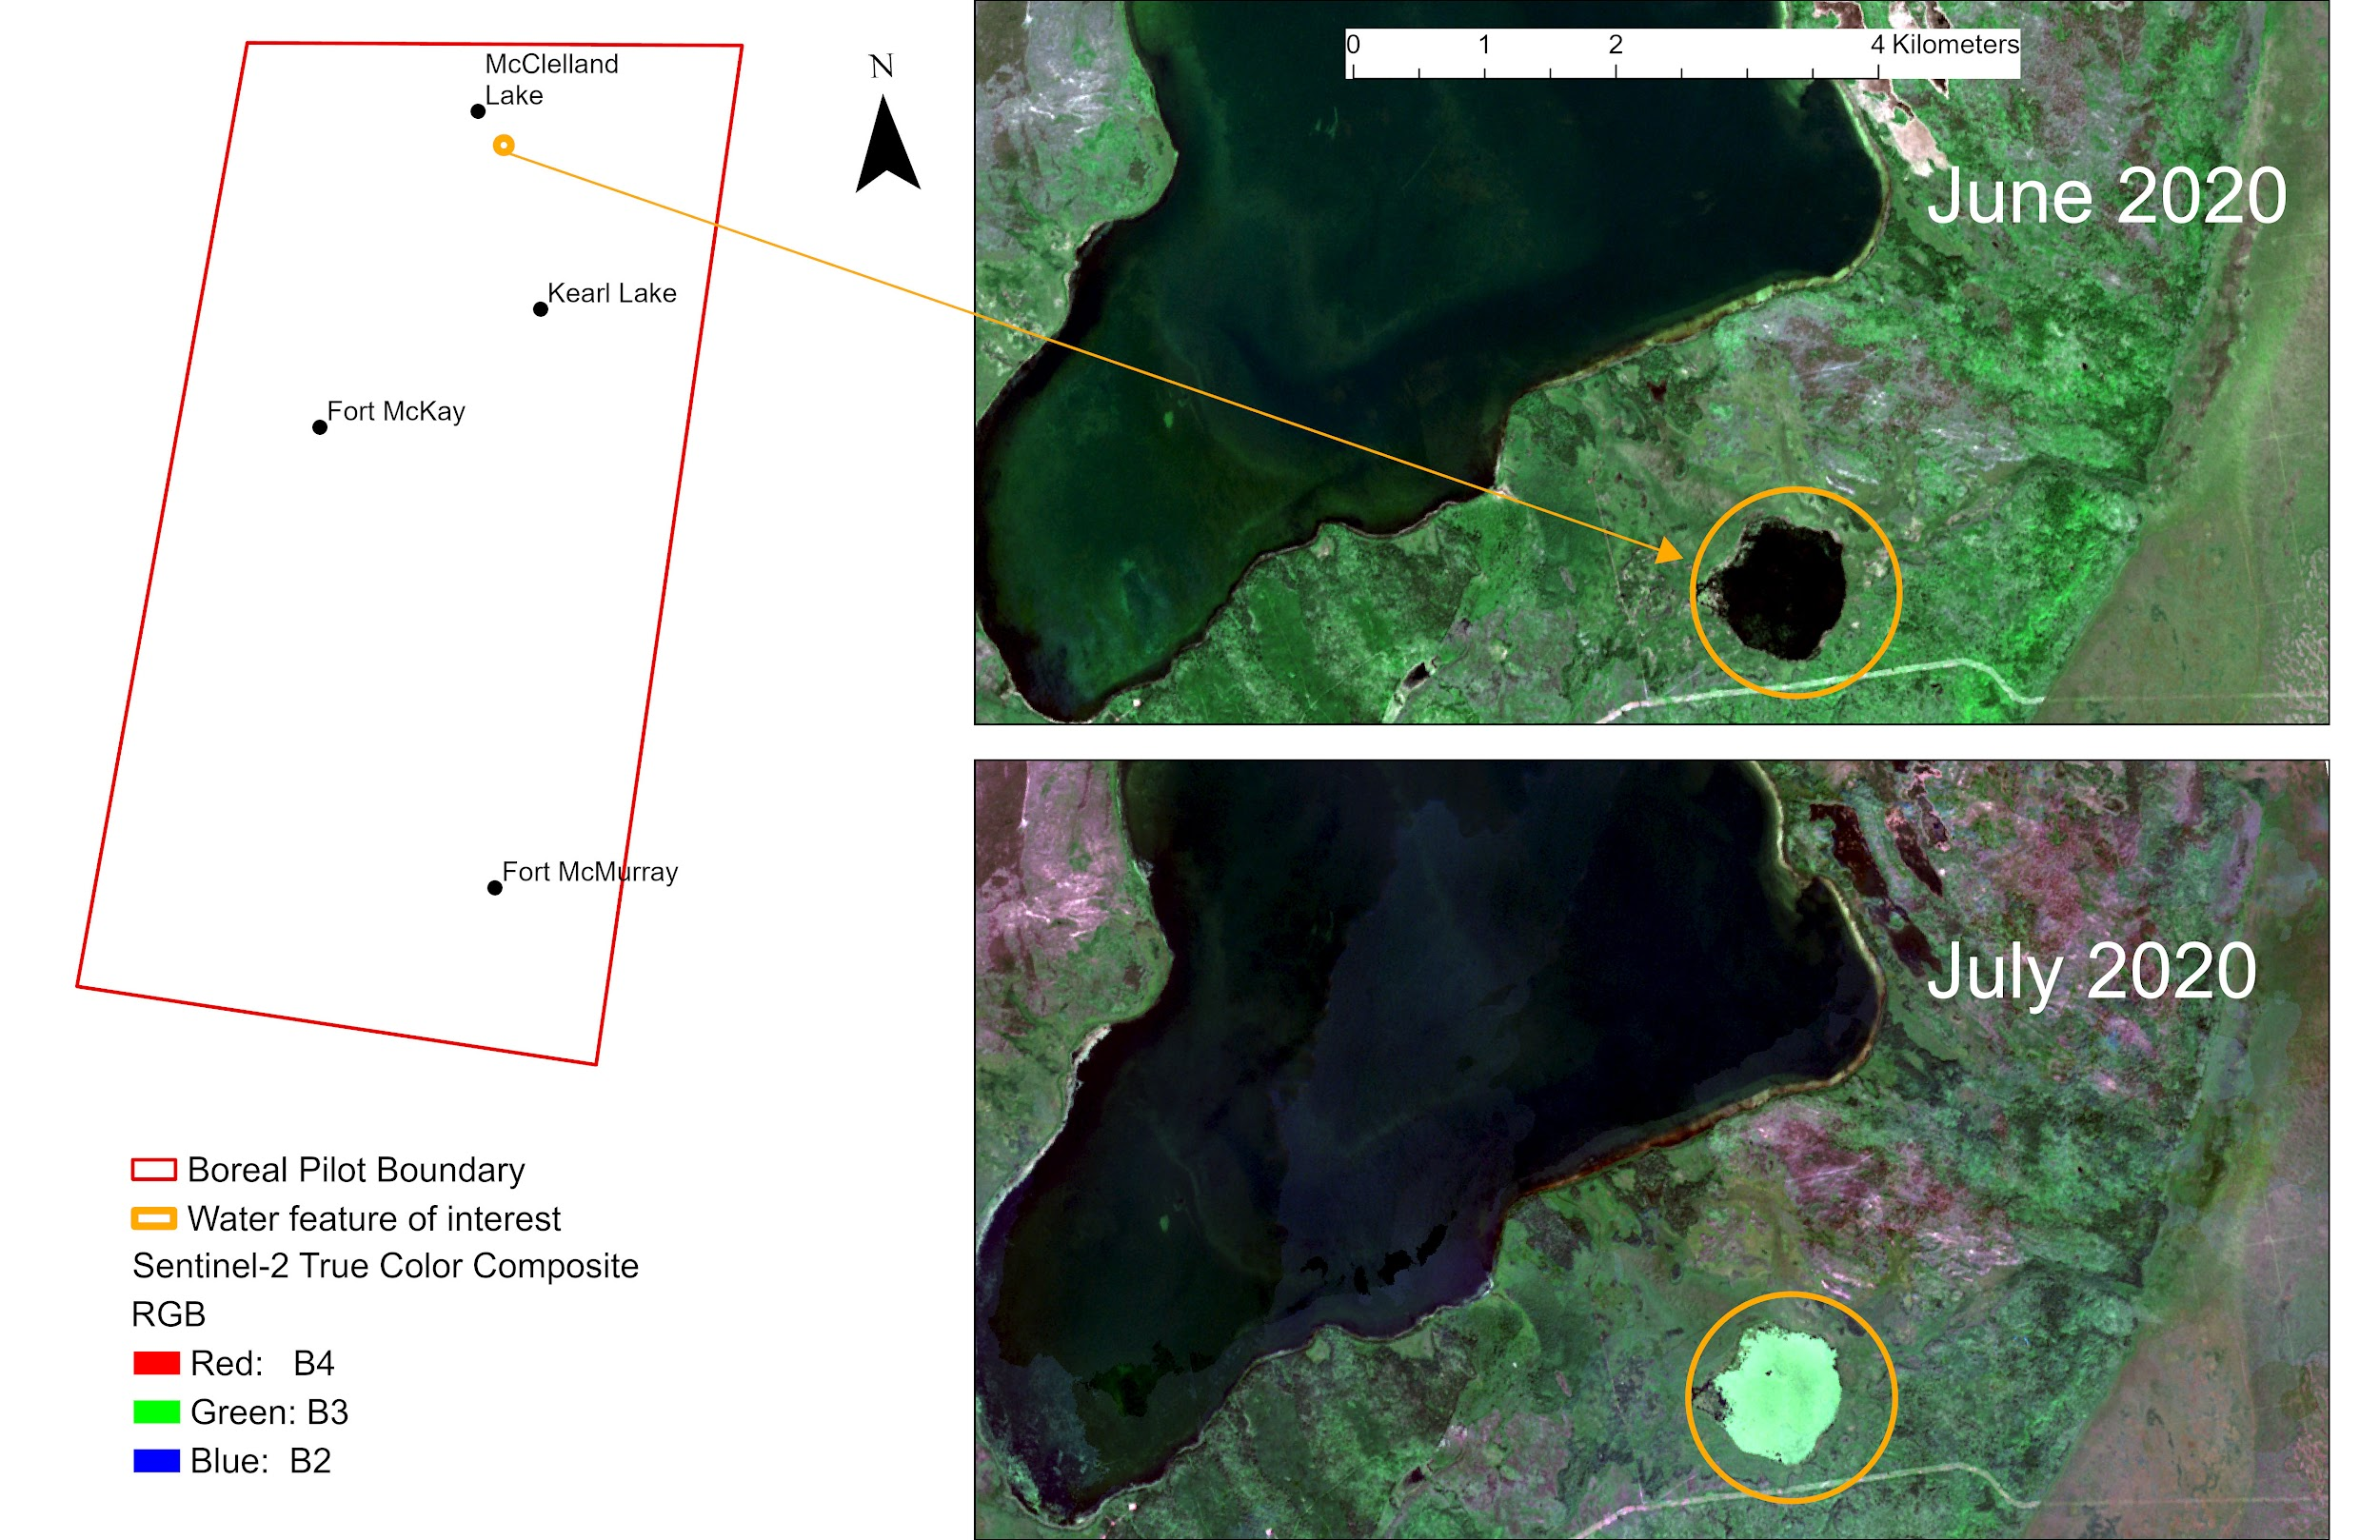

Slide 20
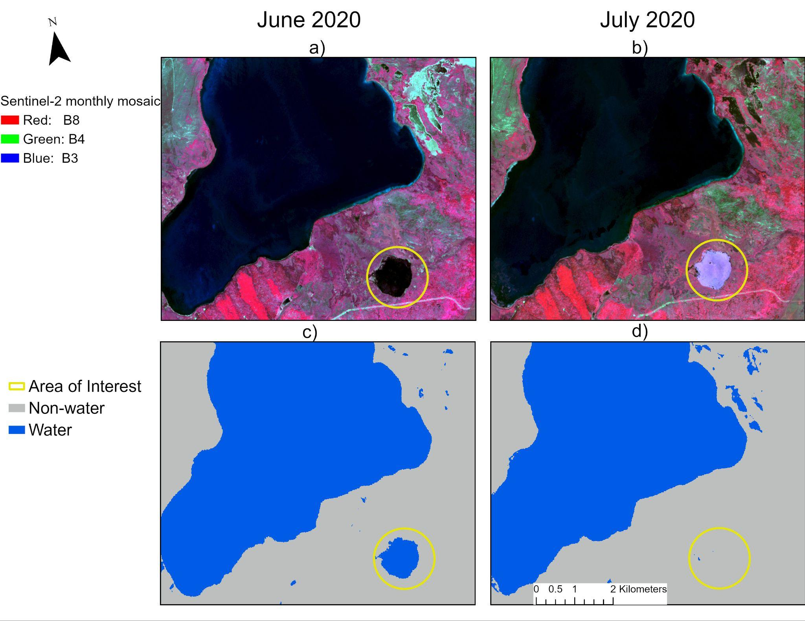

Slide 21
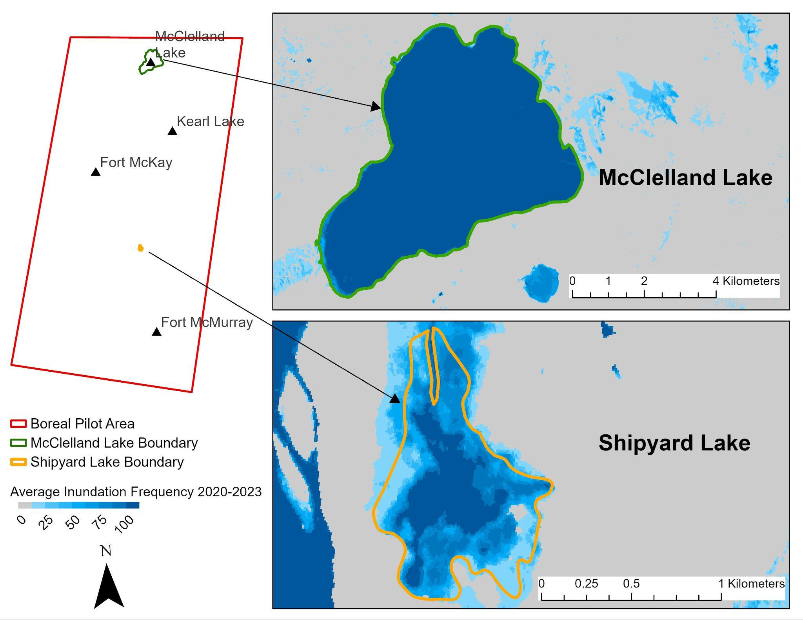
Permanent Lake
Four-year average inundation frequency > 80%
Non-permanent/Recurring Lake
Four-year average inundation frequency < 65%

Slide 22
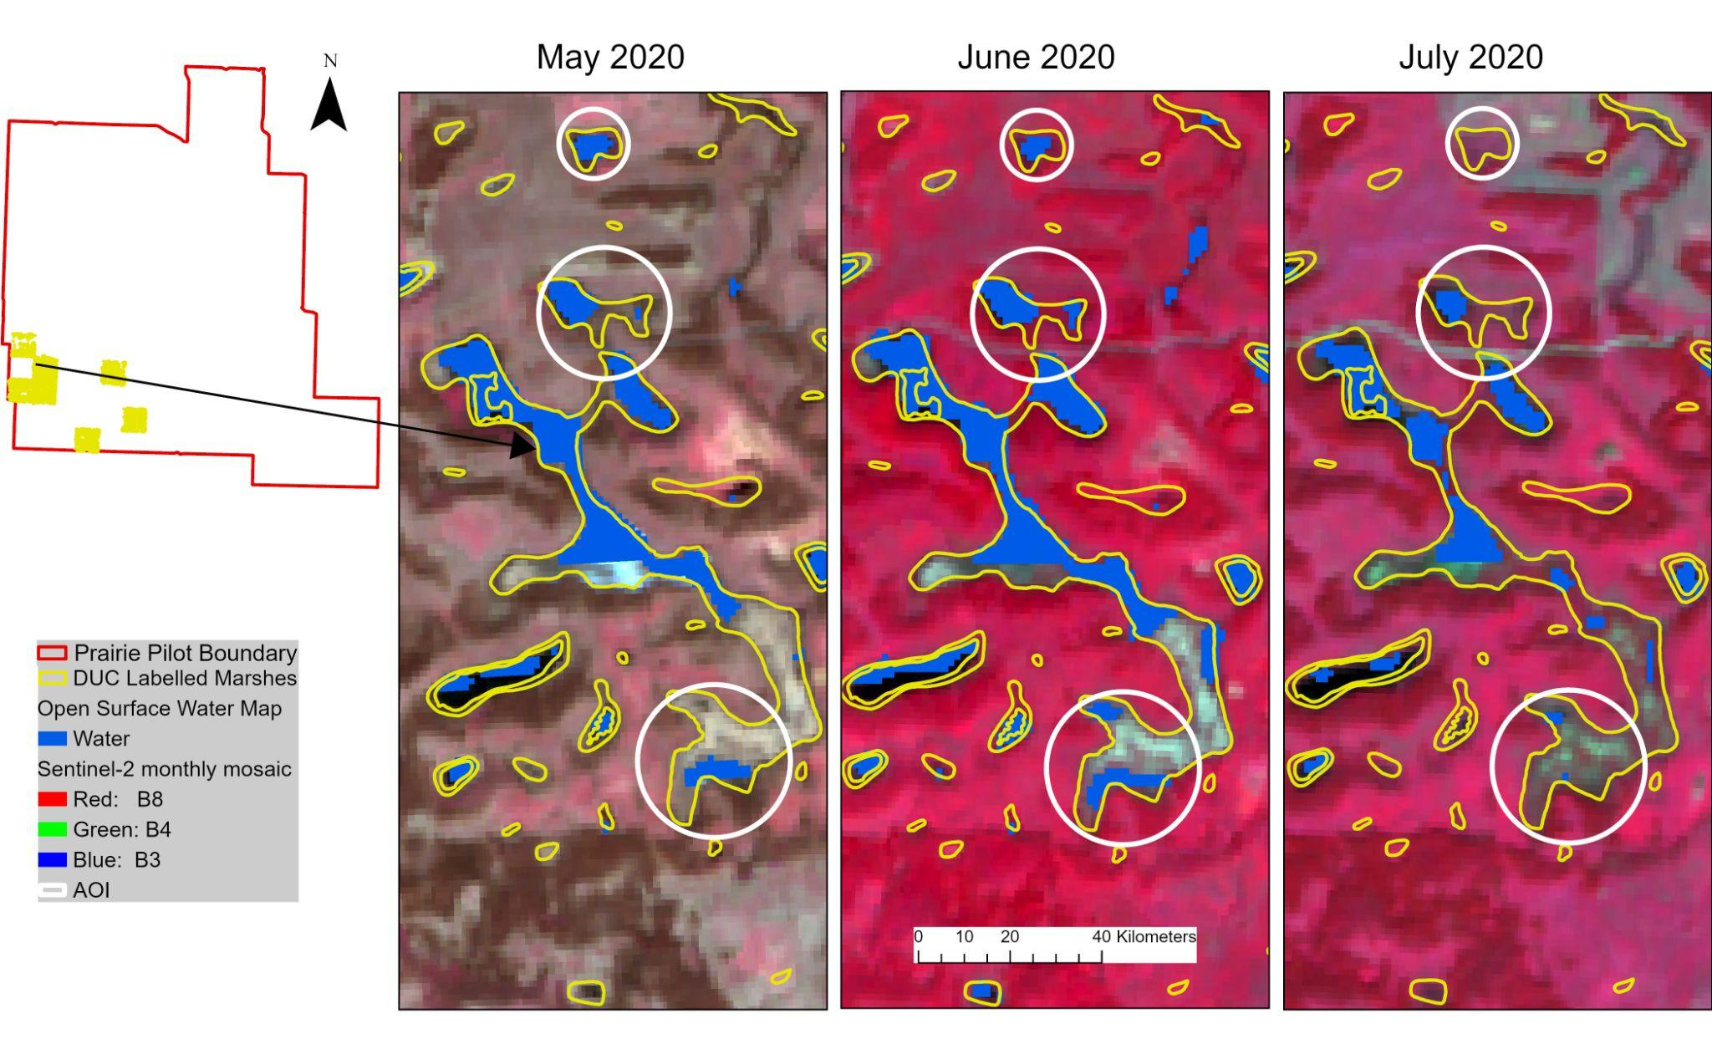

Slide 23
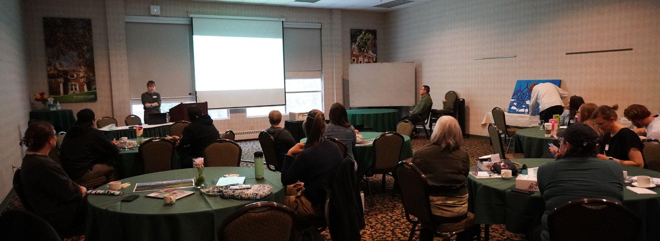
Indigenous Engagement Update
Event held early May on the University of Alberta Campus
Participants included Indigenous community members, Knowledge Holders, and ABMI Staff
Notes:
Representation from Papaschase First Nation, Foothills Ojibway First Nation, Conklin Métis Local 193, Kee-kino Metis Settlement, and Chipewyan Prairie First Nation. There were also members of the Oti-pemisiwak Métis Government, the Faculty of Native Studies, and Braiding Knowledges Canada.

Slide 24
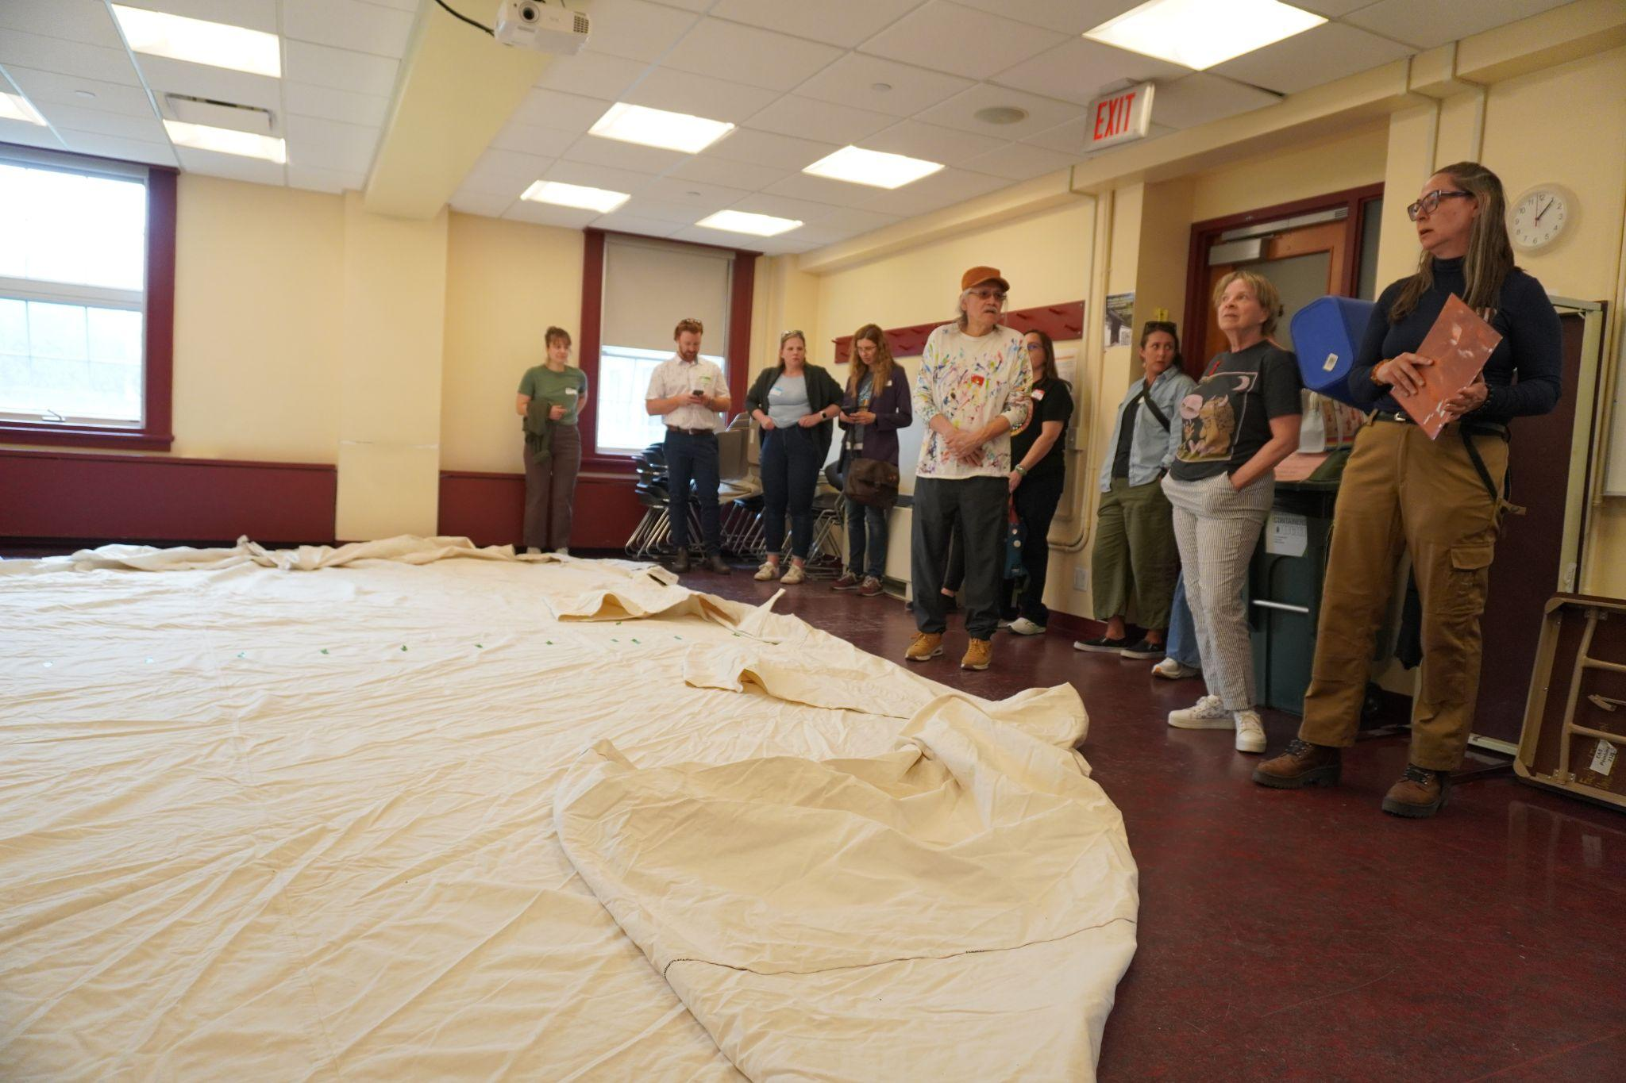
Indigenous engagement update
Aim: welcoming and reflective space
Honored guest Jerry Whitehead live painting
Presentations
Wellness Activity
Discussion Stations

Slide 25
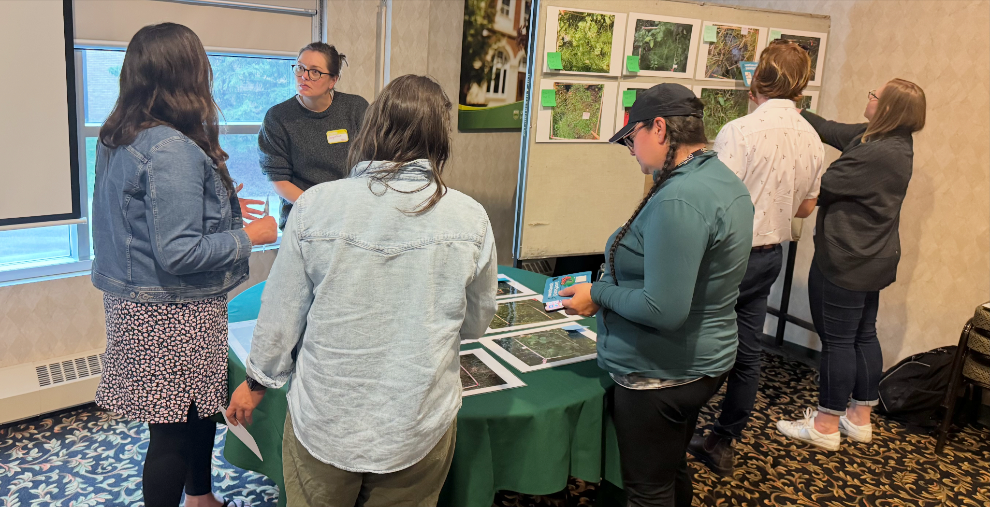
What We Heard
Themes
Historical changes in wetlands
Place-based relationships
Capacity building
Accessible and relevant information / data
Connections between provincial, regional and local scales

Slide 26
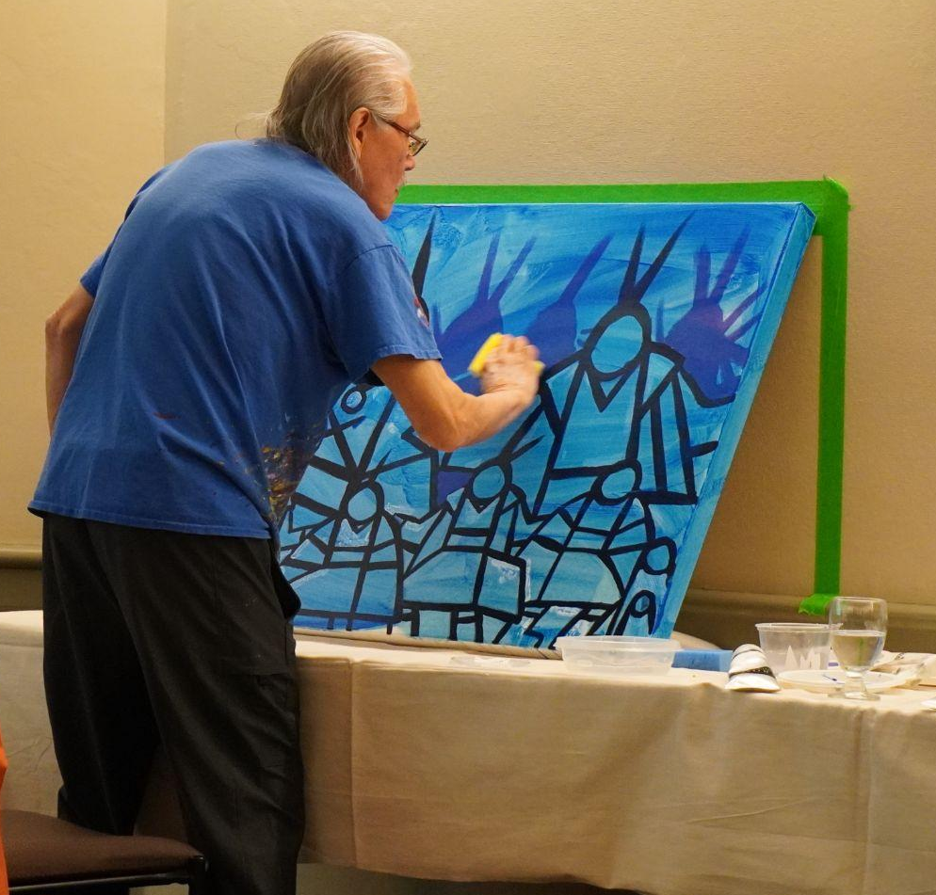
Next Steps
Reflections report produced for participants
Response has been positive
Continued conversations

Slide 27

Thanks and have a great summer!

